Slide 1




Slide 2


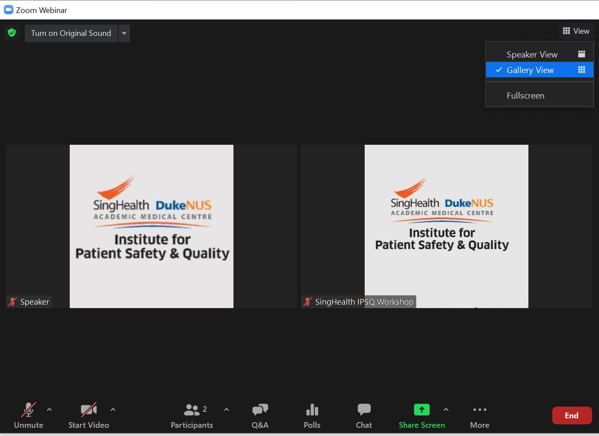

TECHNICAL INSTRUCTIONS
Audio and Video will be disabled for all attendees
Please use the
Chat Box
if you encounter
any technical issues
during the webinar
Click the
Q&A icon
and type your questions
for the Q&A segment

Slide 3
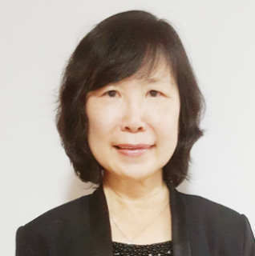


SESSION 3
Change Measurements
Ms Pang Nguk Lan
Director, Quality, Safety & Risk Management, KKH
Deputy Group Director, IPSQ
Dr Alvin Chang
Clinical Director of Quality, Safety & Risk Management, KKH
Senior Consultant, Department of Neonatology, KKH
Dr Siow Yew Nam
Head & Senior Consultant, Anaesthesia (AN-Paeds), KKH

Slide 4


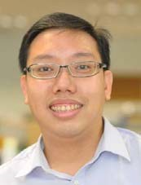
SESSION 3
Change Measurements
Dr Eberta Tan
Senior Consultant, Endocrinology, CGH
Mr John Wong
Assistant Manager, Quality, Safety & Risk Management, KKH
Mr Bernard Wong Yih Terng
Quality Improvement Specialist
Group Quality and Clinical Governance, NHG

Slide 5
Change Management

Slide 6
Session’s Outline
Change Measurements & What are we trying to accomplish? by Dr Alvin
  Project sharing by Dr Siow YN on Opioid Safety Workstream
How will we know that a change is an improvement by Ms Pang
  Project sharing by John Wong on KKH CE
What change can we make that will result in improvement? By Bernard
  Project sharing by Dr Eberta on CGH Hypoglycaemia Prevention Project

Slide 7
Harvest Sheet
 | Strategic Measures (Sydney Australia) | Improvement Aim Measures (Wellington, New Zealand) | PDSA measures (testing changes) (Fiji Islands)
What did I learn (about measurement) ?
What challenges did this team face ?
How did the team overcome their problem/s?
One idea I can try to adopt

Slide 8
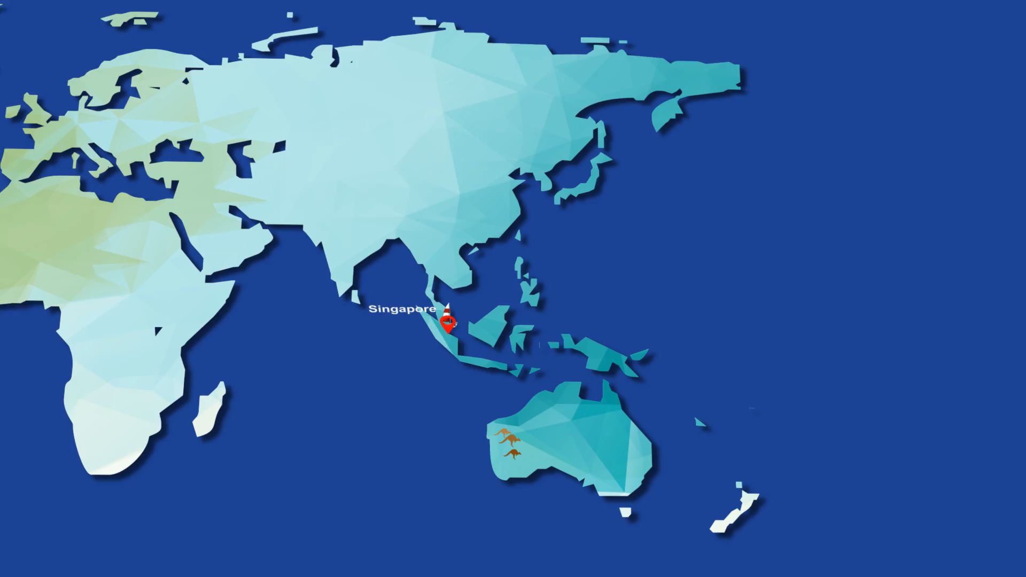

Slide 9

Image By Benh LIEU SONG (Flickr) - Sydney&#039;s Landmarks, CC BY-SA 4.0, https://commons.wikimedia.org/w/index.php?curid=82284288

Slide 10


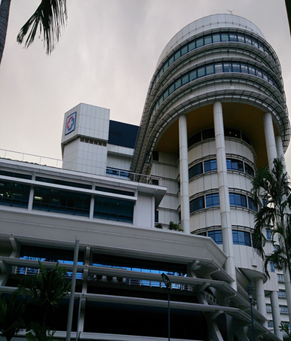
Change Management
Restricted, Non-Sensitive
<Insert cover image here>
Dr Alvin S M Chang
Clinical Director, Quality, Safety and Risk Management (QSRM)
Senior Consultant, Department of Neonatology, KK Women’s and Children’s Hospital,
Cl Asst Prof, DUKE-NUS Medical School, Singapore,
Adj Asst Prof , YLL School of Medicine, National University of Singapore (NUS) and Lee Kong Chian School of Medicine, Nanyang Technology University (NTU), Singapore

Slide 11
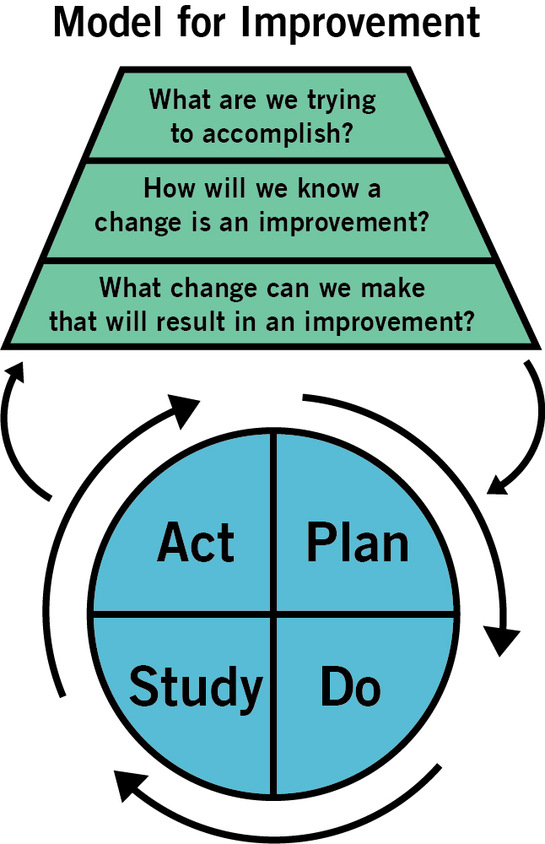
Restricted, Sensitive (Normal)
Notes:
1. Set an aim. A general statement — something like, “We will improve our infection rate” — isn’t good enough. The aim statement should be time-specific and measurable, stating exactly: “How good?” “By when?” and “For whom?”
2. Establish measures. You need feedback to know if a specific change actually leads to an improvement, and quantitative measures can often provide the best feedback.
3. Identify changes. So, how are you going to achieve your aim? Where do new ideas come from? You can spark creative thinking in various ways, and there are tools that can help.
4. Test changes. This is where the PDSA cycle portion of the Model for Improvement comes in. By planning a test of change, trying the plan, observing the results, and acting on what you learn, you will progressively move toward your aim.
5. Implement changes. After you have a change that results in improvement under many conditions, the logical next step is to implement it — meaning, make the change the new standard process in one defined setting.

Slide 12
Building blocks of Change Management
Restricted, Sensitive (Normal)

Slide 13
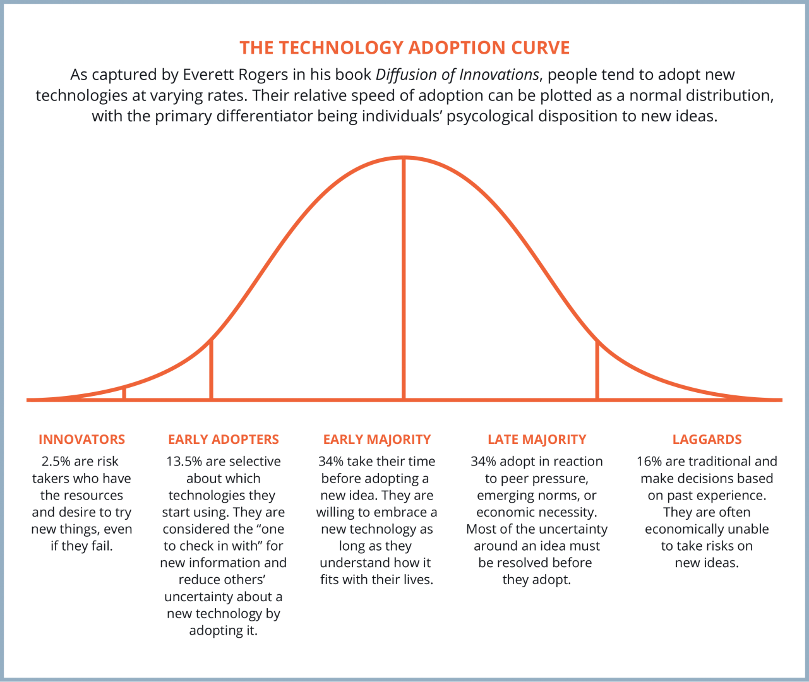
Restricted, Sensitive (Normal)

Slide 14
Driver diagrams
Aim
  Primary drivers
    Secondary drivers
      Actual change ideas / concepts
Develop Measures
Restricted, Sensitive (Normal)

Slide 15
AIM
PRIMARY DRIVERS
SECONDARY DRIVERS
CHANGE IDEAS
Decolonization
Try chlorhexidine washcloths
Reduce transmission of infection and colonization
Screening patients
Test standing order for screening
Reduce by 50% colonization and infection with MRSA by August 1
Good hygiene
Hand hygiene compliance rates
Reduce infection once colonized
Reliable precaution routines
Ensure ideal placement of sanitizer
Bundles
Incorporate adherence checks on rounds
Restricted, Sensitive (Normal)

Slide 16
Tool for communication
Measures
  Outcome
  Process
  Balance
Restricted, Sensitive (Normal)

Slide 17
Process:
Rate of patients who received chlorhexidine wash
AIM
PRIMARY DRIVERS
SECONDARY DRIVERS
CHANGE IDEAS
Outcome:
Rate of MRSA colonization and infections
Decolonization
Try chlorhexidine washcloths
Process:
Percentage of patients screened for MRSA
Reduce transmission of infection and colonization
Screening patients
Test standing order for screening
Process:
Hand hygiene compliance rates
Reduce by 50% colonization and infection with MRSA by August 1
Good hygiene
Hand hygiene compliance rates
Process:
Timely top-ups/replacement of sanitizers
Balance:
Additional cost
Additional resources
Supply chain etc.
Reliable precaution routines
Ensure ideal placement of sanitizer
Reduce infection once colonized
Process:
Compliance rates to bundles
Bundles
Incorporate adherence checks on rounds
Restricted, Sensitive (Normal)

Slide 18
Thank You
Restricted, Sensitive (Normal)

Slide 19

Singhealth Quality
Improvement Day 2021
Opioid Safety Workstream
Restricted, Sensitive (Normal)
Dr Siow Yew Nam
Head & Senior Consultant,
Department of Peadiatric Anaesthesia
12 March 2021

Slide 20

Restricted, Sensitive (Normal)
Restricted, Sensitive (Normal)

Slide 21
AIM
To reduce harm by opioid medications by 30% within next 3 years
Restricted, Sensitive (Normal)

Slide 22
Definitions: Harm
Adverse effects/events/Outcomes
secondary to opioid usage
Need for reversal (Naloxone)
Reported Adverse Events/RMS
Respiratory depression
Restricted, Sensitive (Normal)

Slide 23
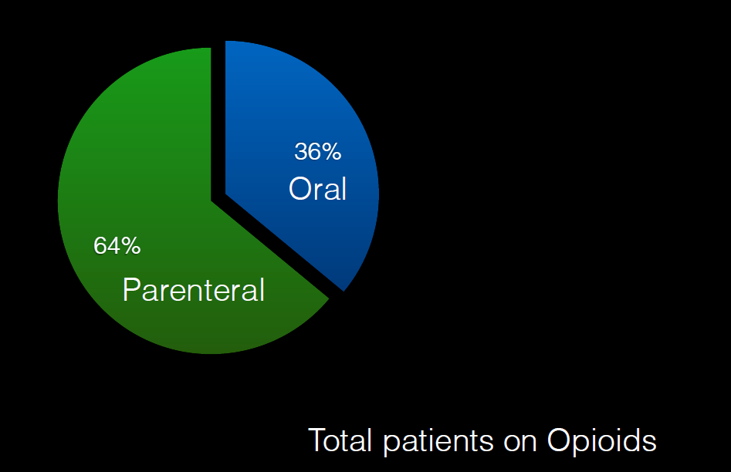
Restricted, Sensitive (Normal)

Slide 24
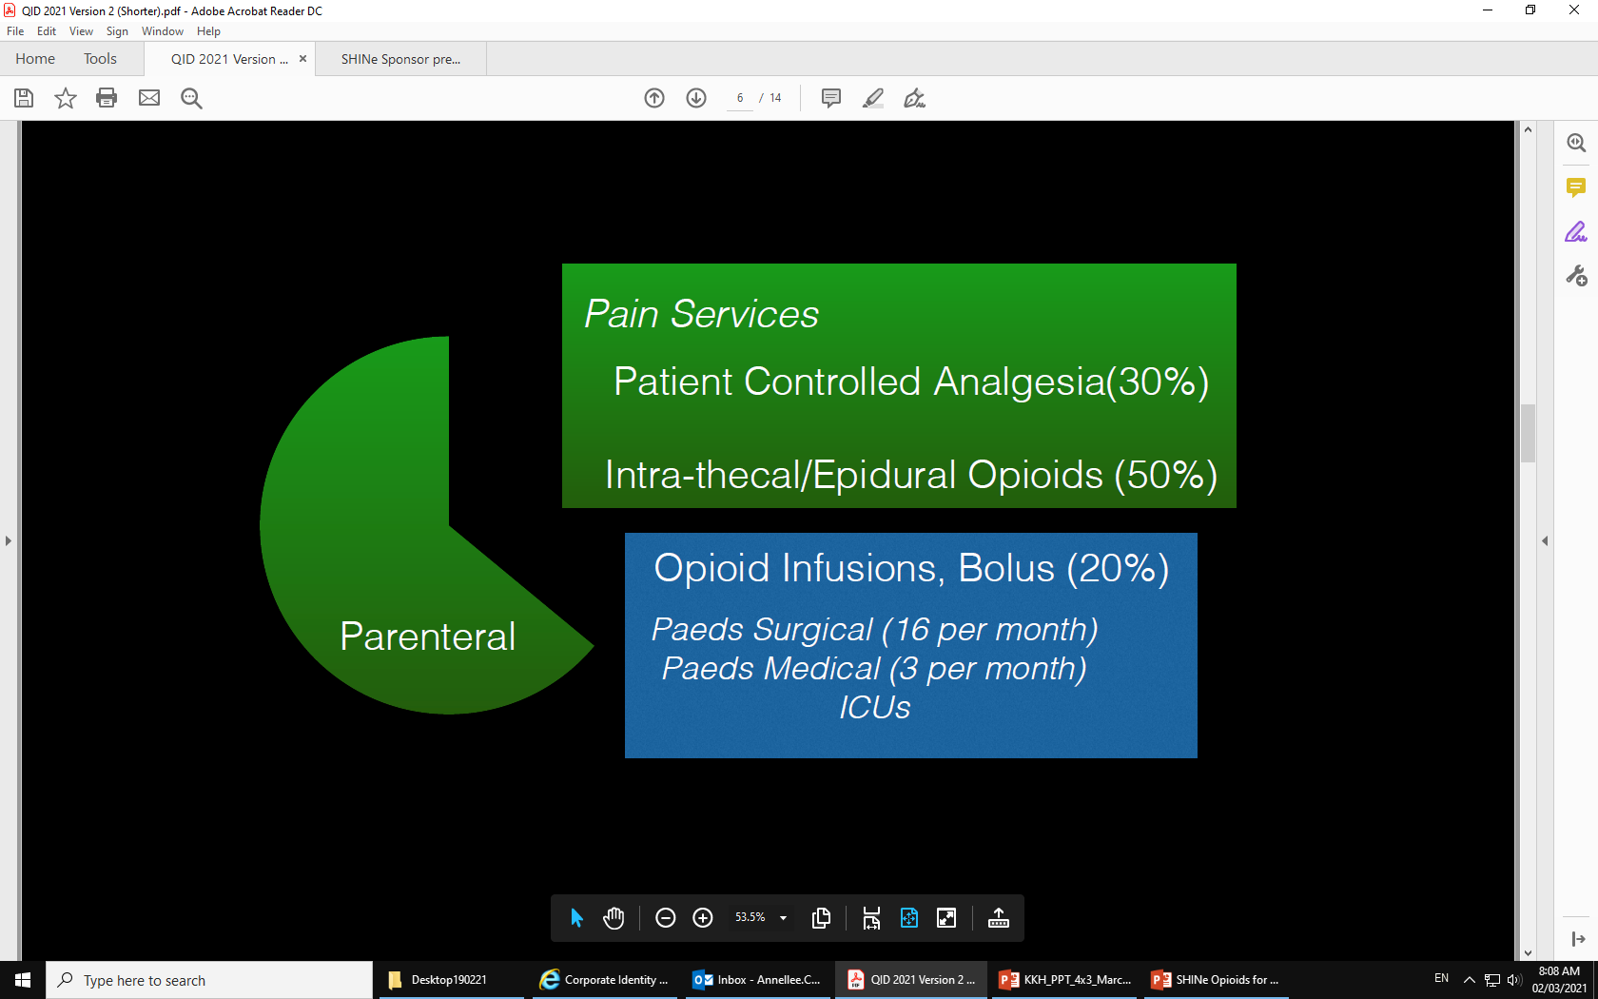
Restricted, Sensitive (Normal)

Slide 25
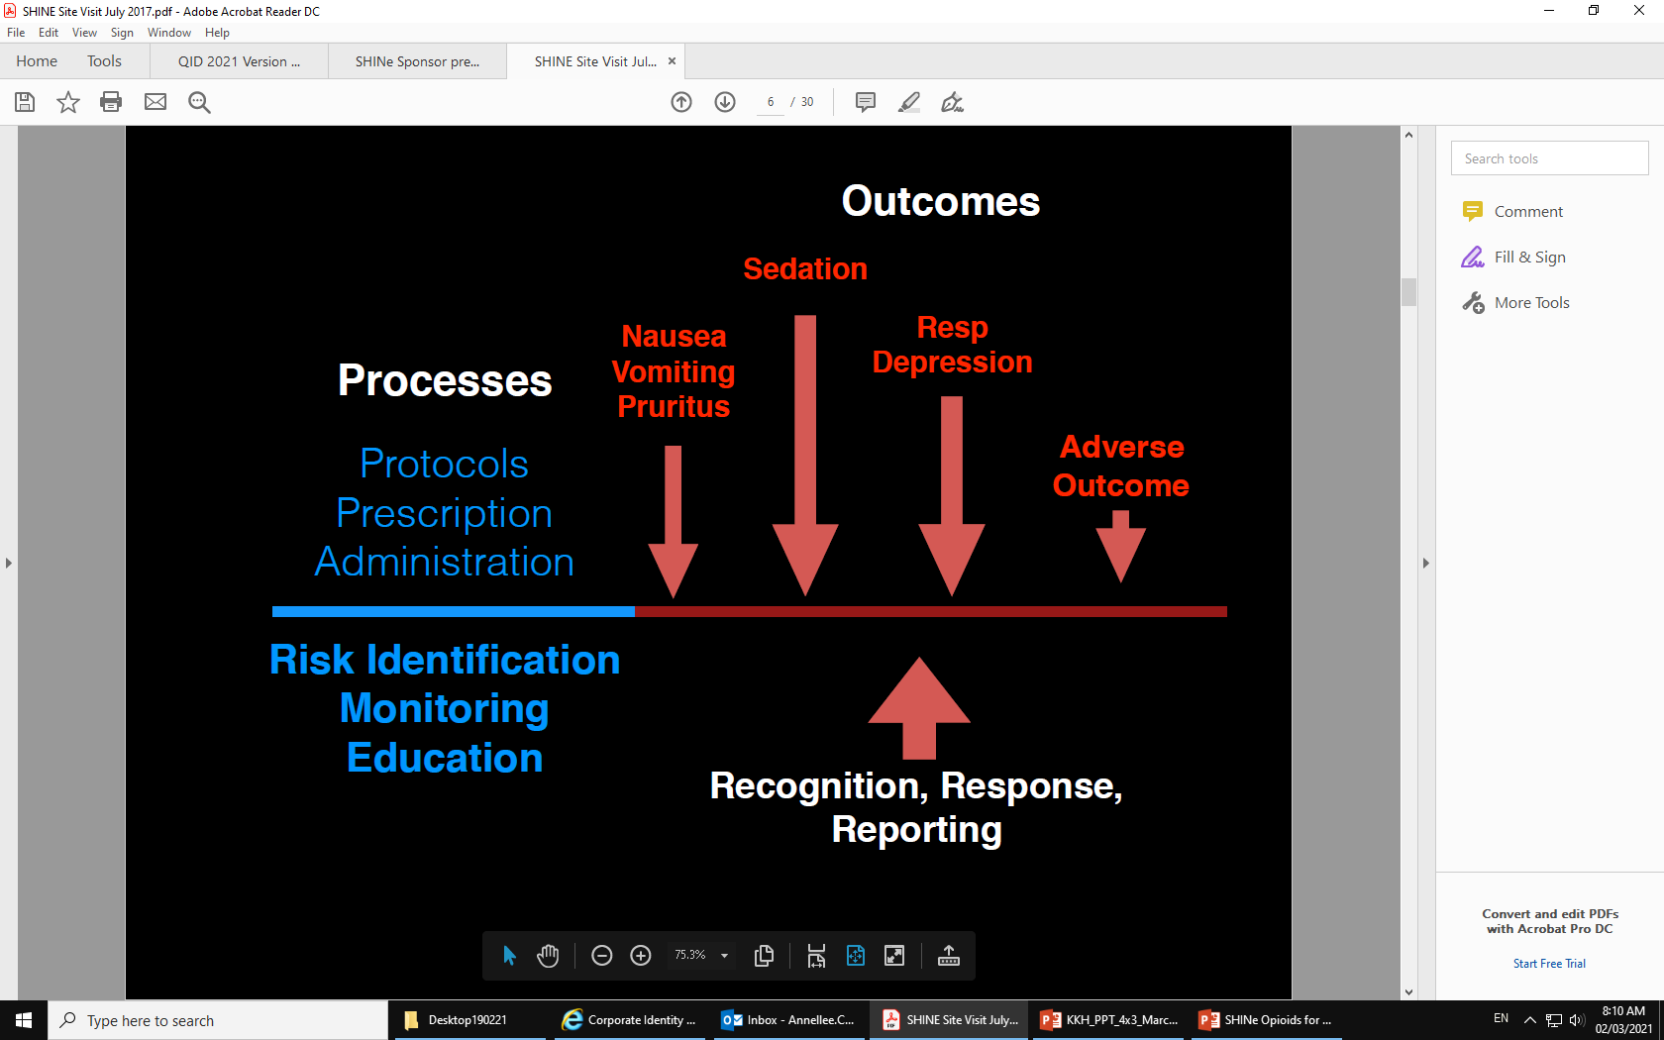
Restricted, Sensitive (Normal)

Slide 26
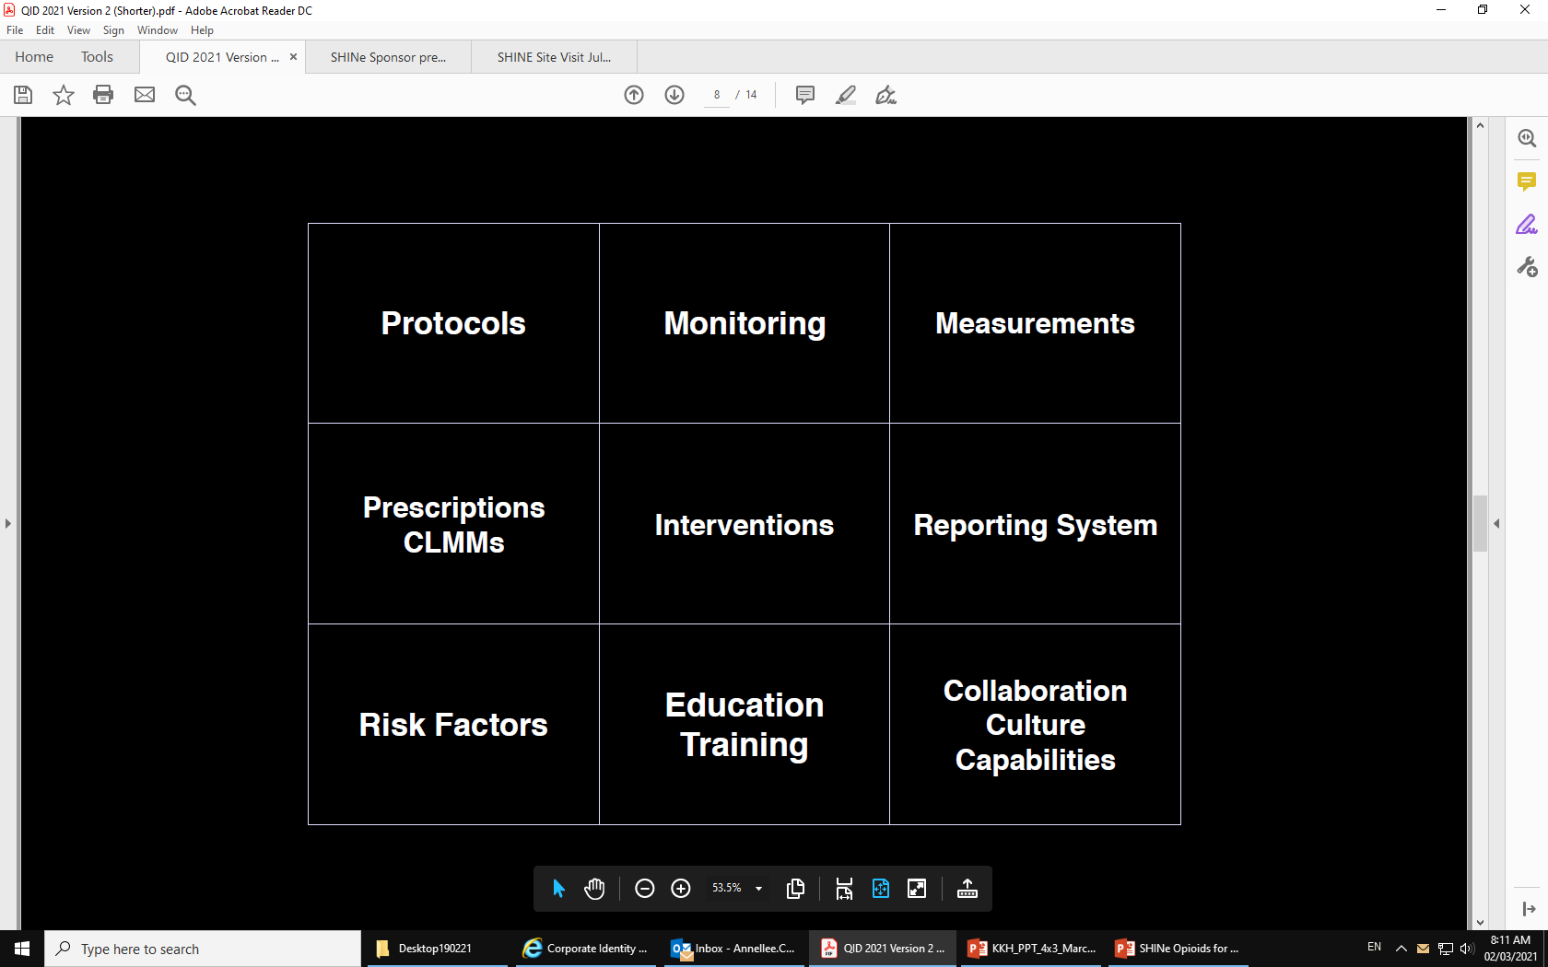
Restricted, Sensitive (Normal)

Slide 27
Aim
Decrease Harm from Opioid administration by 30% in 3 years
Restricted, Sensitive (Normal)

Slide 28
Aim
Primary Driver
Standardize the protocol for Opioids Administration
Decrease Harm from Opioid administration by 30% in 3 years
Develop strategies to improve Opioid Care Delivery
Develop measures to improve Process and Outcomes
Restricted, Sensitive (Normal)

Slide 29
Aim
Primary Driver
Secondary Driver
Protocols
Standardize the protocol for Opioids Administration
Prescription and administration
Decrease Harm from Opioid administration by 30% in 3 years
Develop strategies to improve Opioid Care Delivery
Risk Identification
Monitoring
Develop measures to improve Process and Outcomes
Rescue Interventions
Education and Training
Restricted, Sensitive (Normal)

Slide 30
Aim
Primary Driver
Secondary Driver
Change ideas
Protocols
Development of Morphine Protocol
Revision of existing Pain protocol
Standardize the protocol for Opioids Administration
Prescription and administration
Prescription via CLMM on order sets & monitoring criteria
Decrease Harm from Opioid administration by 30% in 3 years
Develop strategies to improve Opioid Care Delivery
Risk Identification
Opioids Safety Checklist
Monitoring
Pulse Oximetry
Develop measures to improve Process and Outcomes
Management of patienst with induced respiratory depression
Monitoring of patients post-treatment with Naloxone
Rescue Interventions
Opioid Safety Roadshow
Opioid Safety Card & Checklist
Sharing of lessons learned from opioid clinical incidents
Education and Training
Restricted, Sensitive (Normal)

Slide 31
Aim
Primary Driver
Secondary Driver
Change ideas
Standardize the protocol for Opioids Administration
Process - compliance to management according to protocol
Outcome – Days between patients receiving Opiod that require subsequent treatment with Naloxone
Measurements
Decrease Harm from Opioid administration by 30% in 3 years
Strategies to improve Opioid Care Delivery
Reporting System
Electronic Daily Report of patients prescribed with Opioid
Risk Management System
Process and outcome measures
Patient feedback on the Patient Education Checklist and Opioid card
Patient Engagement
Restricted, Sensitive (Normal)

Slide 32
In summary, the 9 key drivers of a safe and effective opioid delivery system
    Protocols to guide all processes for safe opioid administration
    Prescription and administration practices that are consistent and error free
    Identification of patient at high risk factors of developing opioid induced adverse effects/ events
    Monitoring of patients on opioids
    Effective interventions
    Education and training of staffs
    Reporting systems to detect opioid induced adverse effects and surface opioid related incidents/ issues
    Measurements
    Collaboration and patient involvement
Decrease harm
by 30%
in 3 years from opioid administration
Restricted, Sensitive (Normal)

Slide 33

Restricted, Sensitive (Normal)

Slide 34
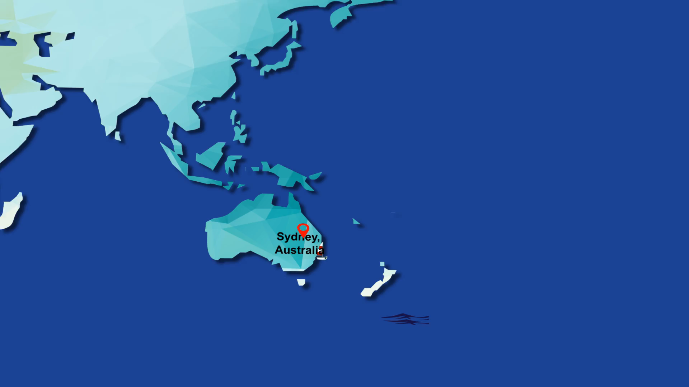

Slide 35

Image by 10wallpaper.com
https://www.10wallpaper.com/view/New_Zealand_coast_cute_sheep_animal_photo.html

Slide 36
Change Measurements: How will we know that a change is an improvement
Pang Nguk Lan
Deputy Group Director, Institute for Patient Safety and Quality
Chief Risk Officer
Director, Quality Safety and Risk Management
March 2021

Slide 37
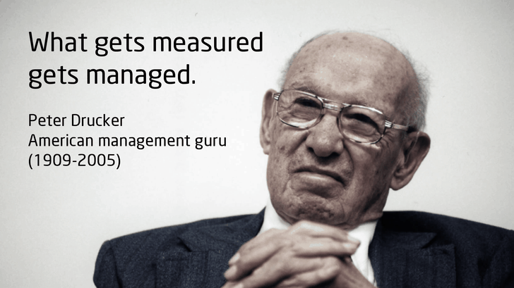
Knowing Where Your Improvement is Heading
Measurement is defined as the act of measuring or quantifying the attributes of something
Translate measurement into usable Information (data) i.e.
for reference or analysis

Slide 38

The Role of Measurement in Quality Improvement
Health service organisations are complex adaptive systems. Making changes to improve quality of care can therefore be complex.
With measurement you can answers to:
What is happening in the delivery of our health services
What factors affect delivery
How we can influence them to achieve improvement.
In a complex system, solid factual evidence is what we need to support decision making, rather than information based on isolated occurrences or assumptions.

Slide 39

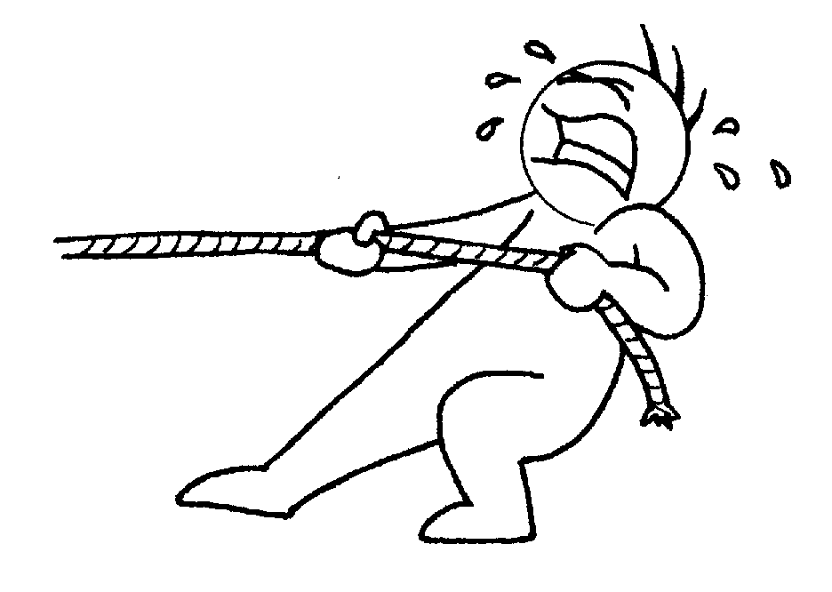
The ‘Push’ and ‘Pull’ of Quality Improvement
Quality Improvement Data
Data helps to ‘push’ improvement by identifying problems
Data helps to ‘pull’ improvement by identifying opportunities

Slide 40

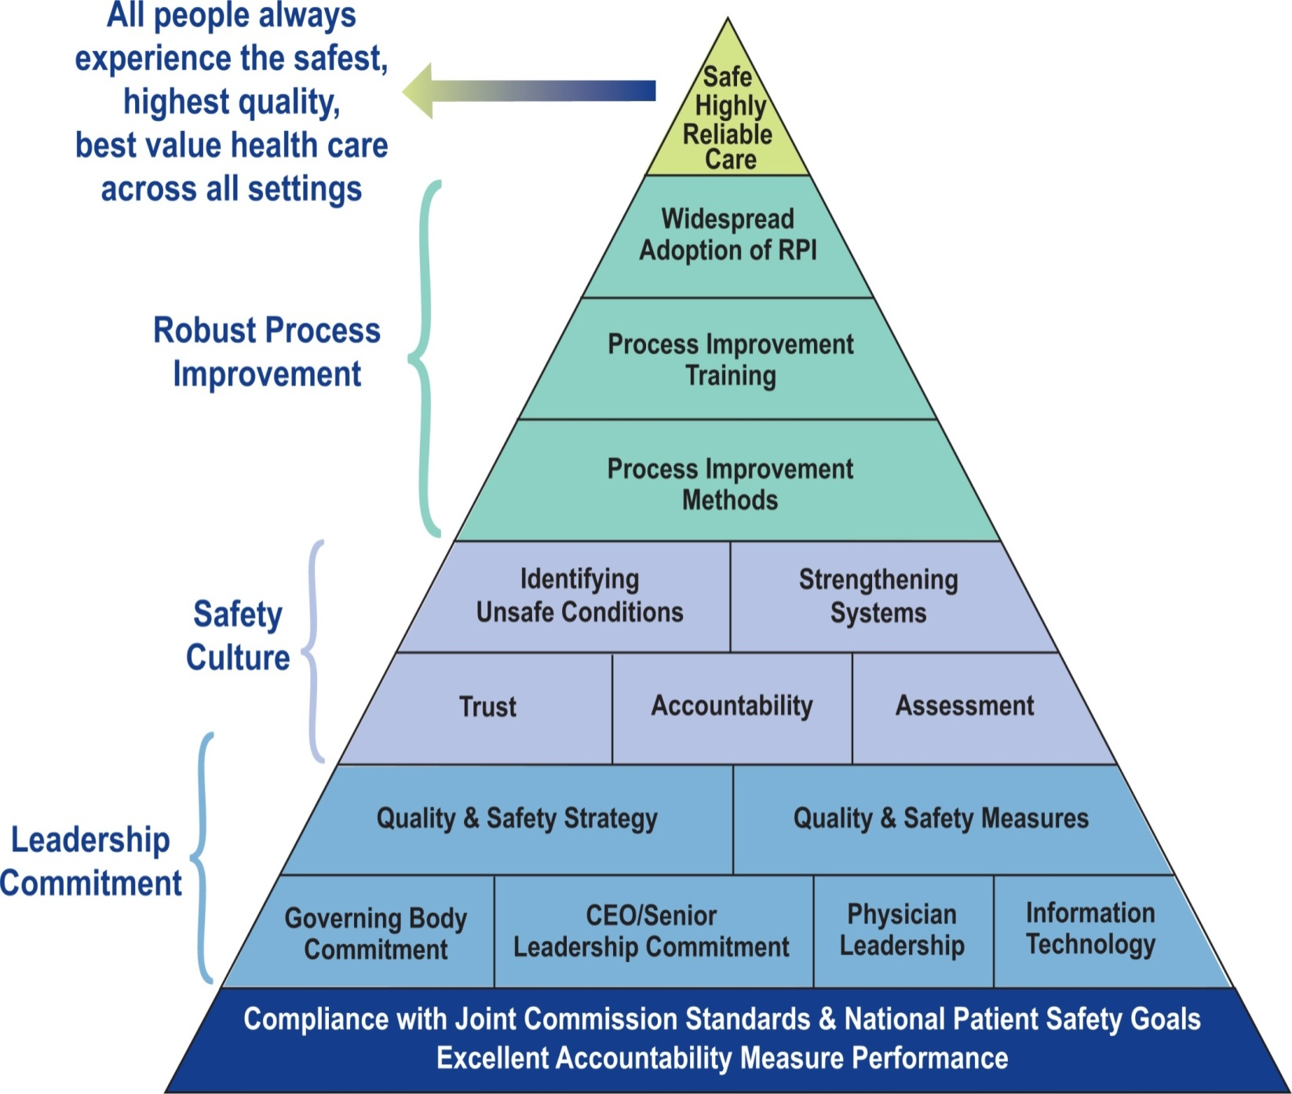
“The Improvement Engine”
Lean, six sigma and change management
Investments in training
Proactive approaches prevail
Transparency in data use
Celebrate improvements
“The Glue”
Patient-centred, safety first
Voicing concerns
Robust reporting
Address behaviours that undermine safety
Engagement in learning and Improvement
Recruitment and on-boarding process
“The Foundation”
Safety is #1 priority, drive safe culture
Commitment is demonstrated by resources
Values transparency
Learning organisation
Maintain full accountability
Data Driven

Slide 41

Measurement for Improvement
Healthcare services must proactively l k for opportunities to improve.
Opportunities become evident when the processes and outcomes are measured and examined.
Data plays an important role in each of these improvement phases:
Tackle the right problem
Implement the right strategies/solutions
Demonstrate the required outcome and monitor for continued improvement

Slide 42


Successful Measurement for Improvement
What gets measured get managed - Know if the changes you are making are leading to improvement?
The key to measurements:
Pick the right measurements,
Measure and see results
With the information at hand you adapt your interventions accordingly
Measure and focus on the outcomes you want it to lead to

Slide 43

Make Measurement Rewarding
Make measuring an learning experience
Clarify the aim, set attainable goals which can effect change and make it tangible
Make measurement meaningful where it generate into a productive process
Use sampling to make measurement efficient and representative
Integrate measurement into people’s daily routine.
Plot data on the measures over time.

Slide 44
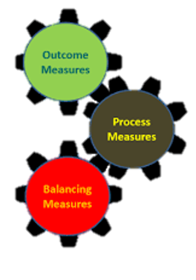
Use multiple measures
Choose measures to allow you to see changes you are making:
Outcome Measures (voice of the customer or patient):
  How is the system performing? What is the result?
Process Measures (voice of the workings of the system):
Are the parts/steps in the system performing as planned?
Balancing Measures (looking at a system from different directions):
Are changes designed to improve one part of the system causing new problems in other parts of the system?

Slide 45
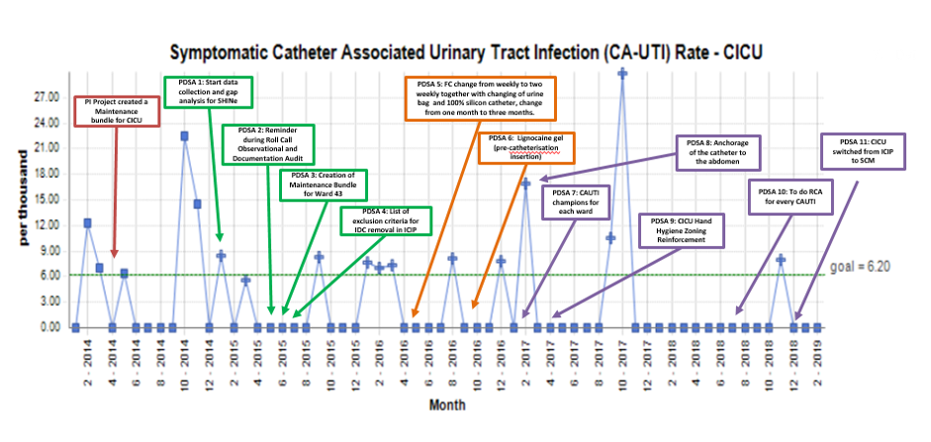
Choose Appropriate Statistics Tools and Sampling Size
Annotate graphs the reader can see the effect of changes you are testing e.g.
Ratios give a more realistic picture than simply counting numbers of incidences in measuring volume e.g. if patients waiting time had increased dramatically, look at the overall volume had also increased.
Use sampling to get "just enough data" to see if changes are leading to improvement.
Display your measures often enough to give your team feedback in a timely manner.

Slide 46
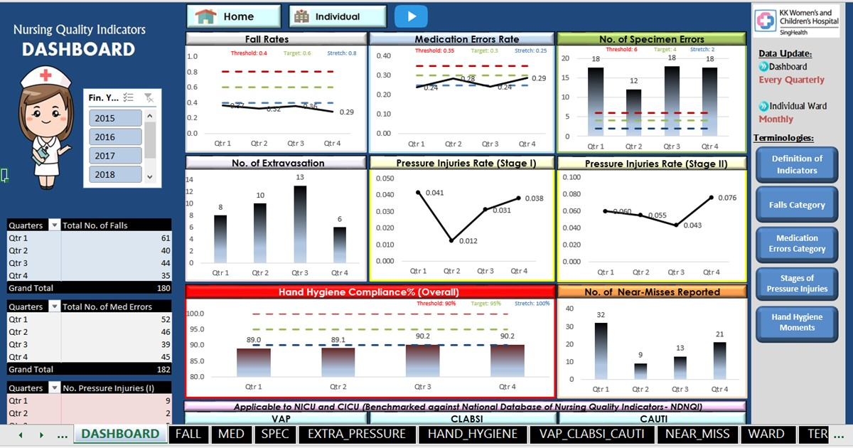
Develop Visual Displays of Measures
There are various techniques for organising and presenting data which are helpful in guiding visual analysis and are also valuable for communicating your findings and decision making.
Dashboards provide a central location for users to access, interact and analyse up-to-date information to make data-driven decisions more quickly.
Clinical Events Story Board – Provide visual analysis and allow data users to dwell to specific problem or opportunities for improvement.

Slide 47

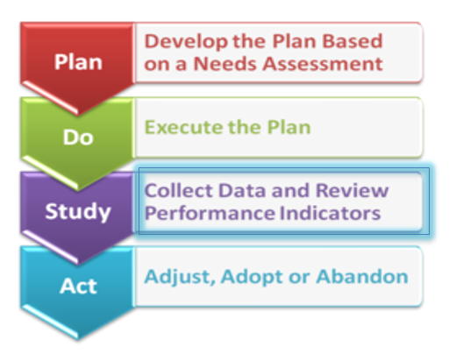
Measurement – a tool to Improvement Strategy
Project initiation phase –Identifying the potential problem area.
Diagnosis phase – Diagnose potential problems for improvement.
Intervention phase –Determining interventions and monitoring the progress.
Sustainability phase – Measurement for refinement of interventions as well as to sustain the improvement

Slide 48
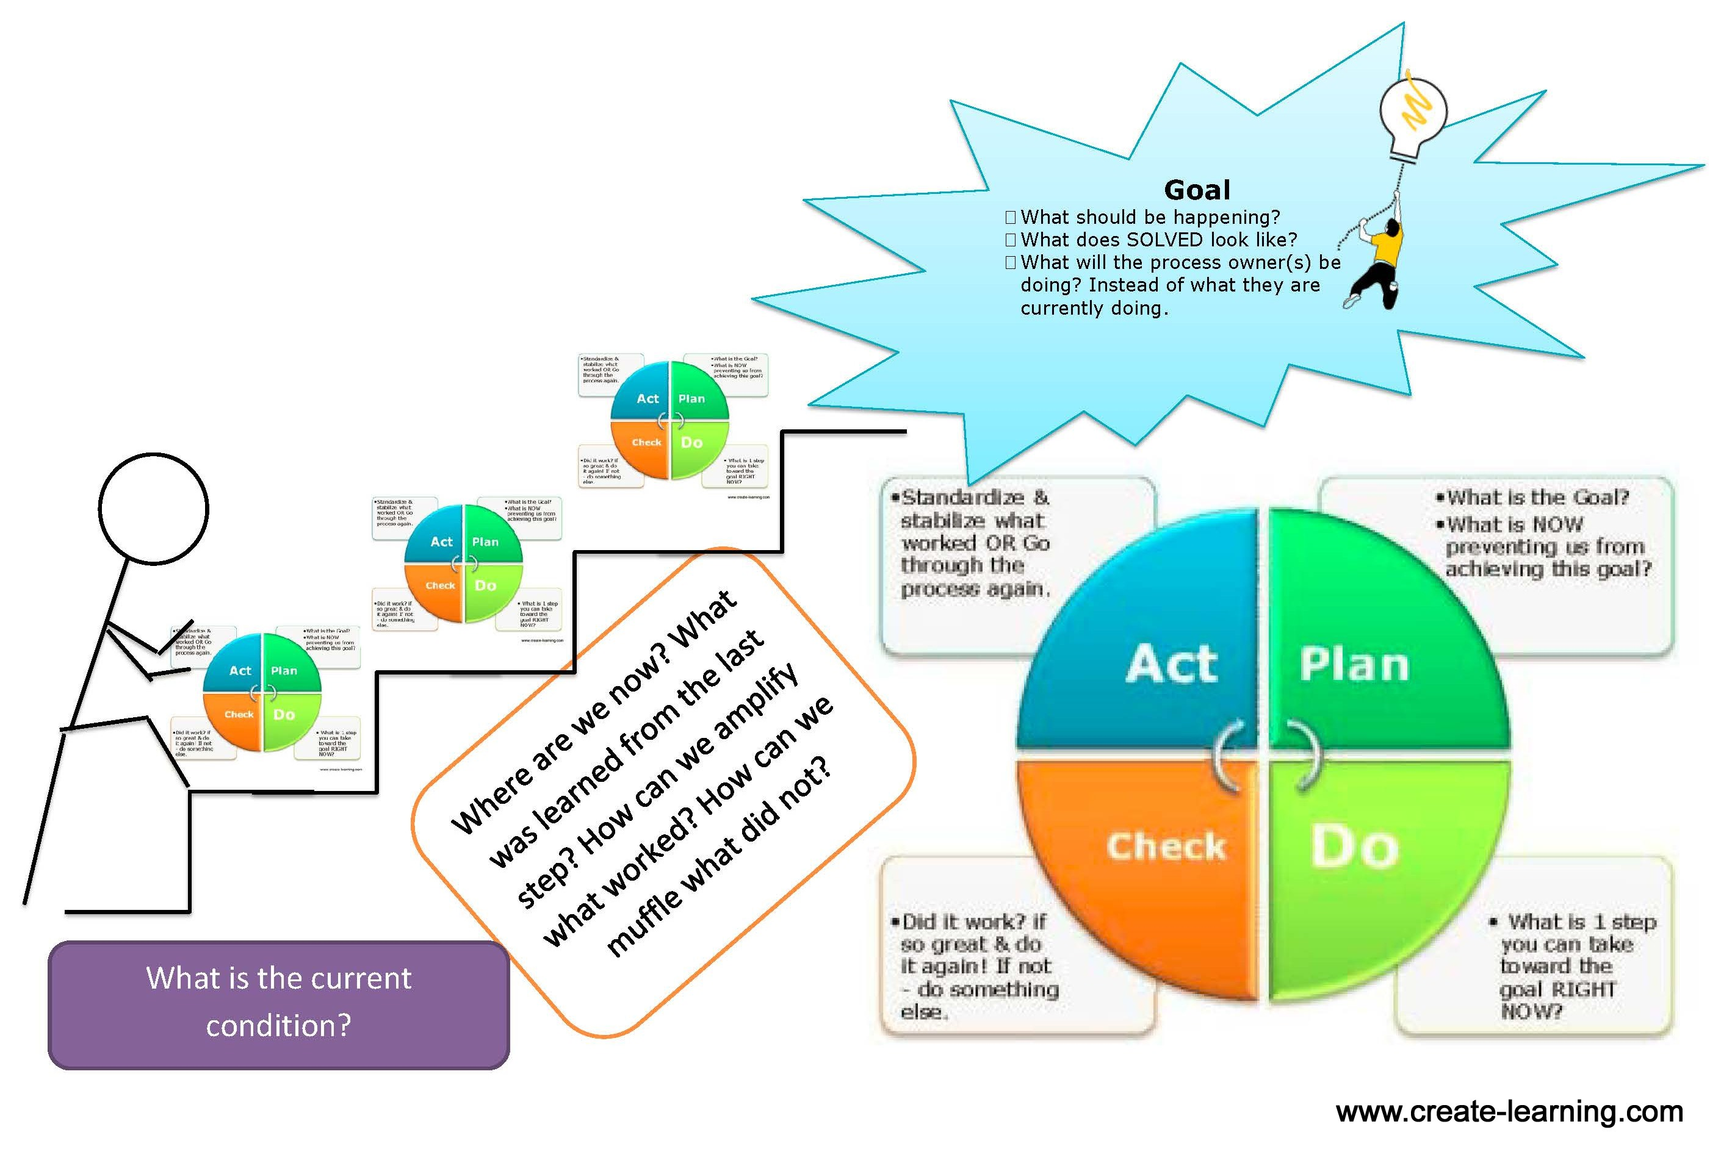
With Measurement.. You know….
Where you are…
What was learned…
What worked and what don’t…
What next…

Slide 49





Slide 50
Change Management
How we know that a change is an improvement
Wong Chi Keong John
KKH Quality, Safety and Risk Management
12 Mar 2021

Slide 51
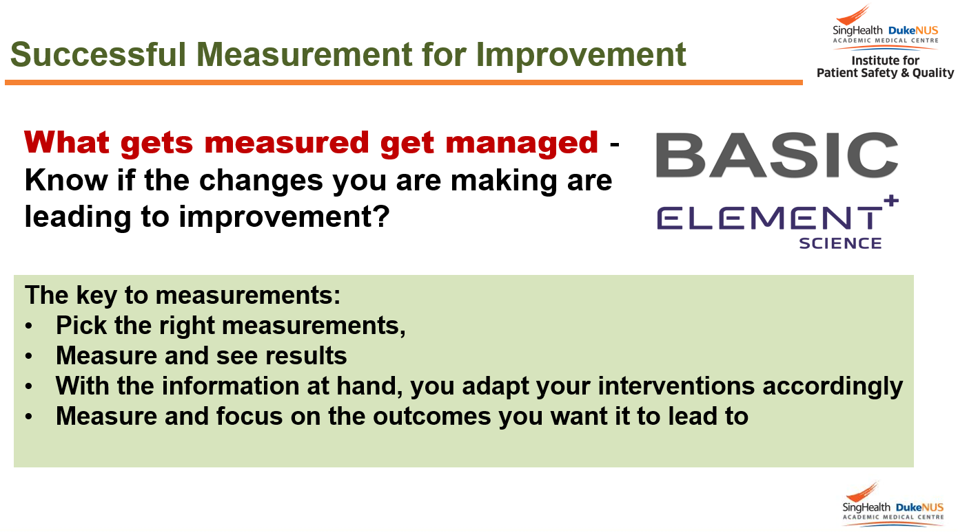
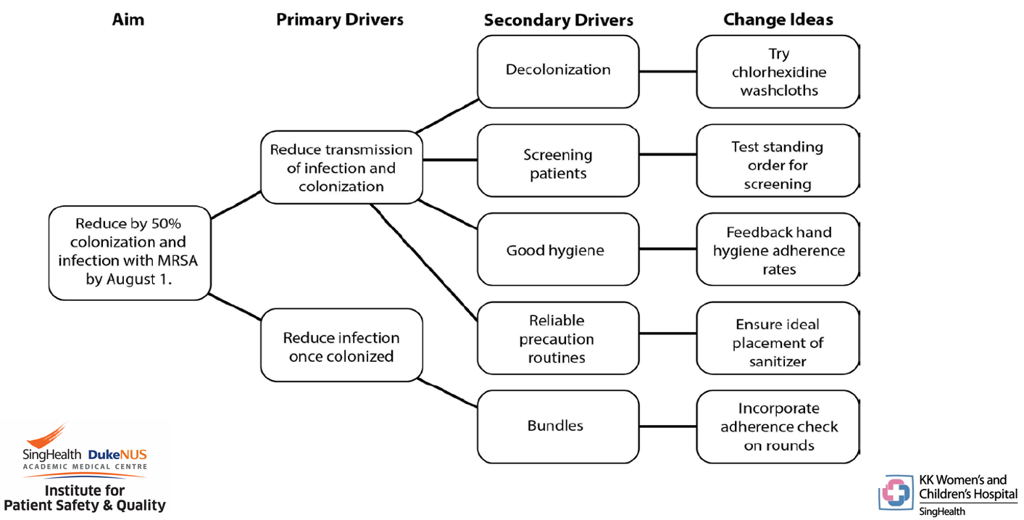
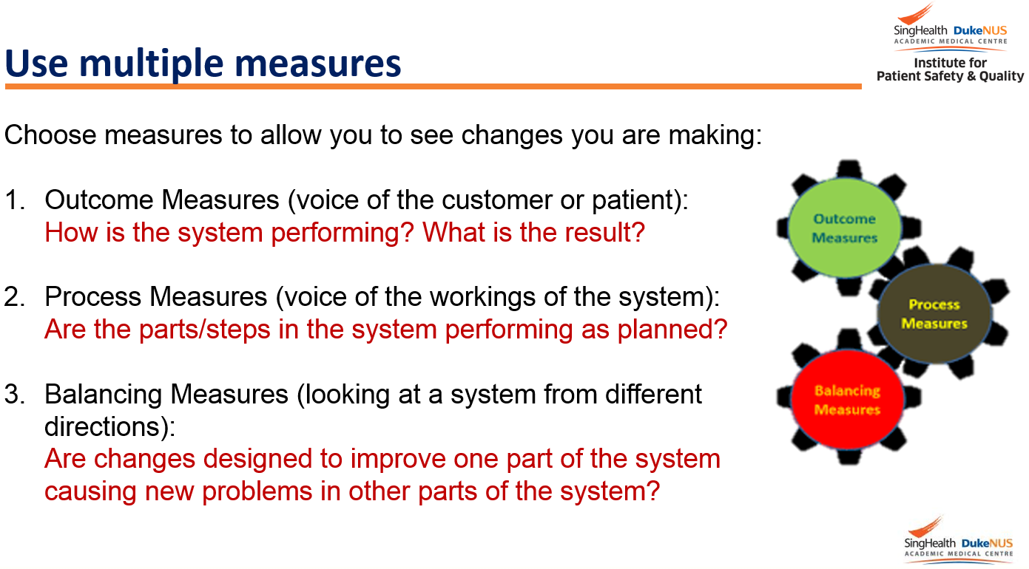
From previous presentations …
Demonstrate these points here …
Pick the right measurements
Use multiple measures together with driver diagrammes

Slide 52
How will we know that a change is an improvement
You make a change
You did not see an improvement
Is there really no improvement?
Vaccination in ward

Slide 53
Vaccination in ward
Ward | Jan vax | Adm | Vax Per 100 Adm | Feb vax | Adm | Vax Per 100 Adm | Mar vax | Adm | Vax Per 100 Adm
31 | 2 | 307 | 0.65 | 0 | 182 | 0 | 0 | 148 | 0
56 | 0 | 435 | 0 | 1 | 291 | 0.34 | 0 | 227 | 0
62 | 1 | 374 | 0.27 | 0 | 258 | 0 | 0 | 201 | 0
… | … | … | … | … | … | … | … | … | …
Will “Vax Per 100 Adm” show your improvement?
How do you know?
Let’s model the system and situation

Slide 54
Vaccination in ward
Ward | Jan vax | Adm | Vax Per 100 Adm | Feb vax | Adm | Vax Per 100 Adm | Mar vax | Adm | Vax Per 100 Adm
31 | 2 | 307 | 0.65 | 0 | 182 | 0 | 0 | 148 | 0
56 | 0 | 435 | 0 | 1 | 291 | 0.34 | 0 | 227 | 0
62 | 1 | 374 | 0.27 | 0 | 258 | 0 | 0 | 201 | 0
… | … | … | … | … | … | … | … | … | …
Admitted
Checked
Qualified
Not checked
Not qualified
Offered
Not offered
Accepted
Rejected
Vaccinated
Not vaccinated

Slide 55
Vaccination in ward
Ward | Jan vax | Adm | Vax Per 100 Adm | Feb vax | Adm | Vax Per 100 Adm | Mar vax | Adm | Vax Per 100 Adm
31 | 2 | 307 | 0.65 | 0 | 182 | 0 | 0 | 148 | 0
56 | 0 | 435 | 0 | 1 | 291 | 0.34 | 0 | 227 | 0
62 | 1 | 374 | 0.27 | 0 | 258 | 0 | 0 | 201 | 0
… | … | … | … | … | … | … | … | … | …
Admitted
Checked
Qualified
Not checked
Not qualified
Offered
Not offered
Accepted
Rejected
Vaccinated
Not vaccinated

Slide 56
Vaccination in ward
Ward | Jan vax | Adm | Vax Per 100 Adm | Feb vax | Adm | Vax Per 100 Adm | Mar vax | Adm | Vax Per 100 Adm
31 | 2 | 307 | 0.65 | 0 | 182 | 0 | 0 | 148 | 0
56 | 0 | 435 | 0 | 1 | 291 | 0.34 | 0 | 227 | 0
62 | 1 | 374 | 0.27 | 0 | 258 | 0 | 0 | 201 | 0
… | … | … | … | … | … | … | … | … | …
Admitted
Checked
Qualified
Not checked
Not qualified
Offered
Not offered
Accepted
Rejected
Vaccinated
Not vaccinated

Slide 57
Vaccination in ward
Ward | Jan vax | Adm | Vax Per 100 Adm | Feb vax | Adm | Vax Per 100 Adm | Mar vax | Adm | Vax Per 100 Adm
31 | 2 | 307 | 0.65 | 0 | 182 | 0 | 0 | 148 | 0
56 | 0 | 435 | 0 | 1 | 291 | 0.34 | 0 | 227 | 0
62 | 1 | 374 | 0.27 | 0 | 258 | 0 | 0 | 201 | 0
… | … | … | … | … | … | … | … | … | …
Admitted
Checked
Qualified
Not checked
Not qualified
Offered
Not offered
Accepted
Rejected
Vaccinated
Not vaccinated

Slide 58
Vaccination in ward
Ward | Jan vax | Adm | Vax Per 100 Adm | Feb vax | Adm | Vax Per 100 Adm | Mar vax | Adm | Vax Per 100 Adm
31 | 2 | 307 | 0.65 | 0 | 182 | 0 | 0 | 148 | 0
56 | 0 | 435 | 0 | 1 | 291 | 0.34 | 0 | 227 | 0
62 | 1 | 374 | 0.27 | 0 | 258 | 0 | 0 | 201 | 0
… | … | … | … | … | … | … | … | … | …
Admitted
Checked
Qualified
Not checked
Not qualified
Offered
Not offered
Accepted
Rejected
Vaccinated
Not vaccinated

Slide 59
Vaccination in ward
Ward | Jan vax | Adm | Vax Per 100 Adm | Feb vax | Adm | Vax Per 100 Adm | Mar vax | Adm | Vax Per 100 Adm
31 | 2 | 307 | 0.65 | 0 | 182 | 0 | 0 | 148 | 0
56 | 0 | 435 | 0 | 1 | 291 | 0.34 | 0 | 227 | 0
62 | 1 | 374 | 0.27 | 0 | 258 | 0 | 0 | 201 | 0
… | … | … | … | … | … | … | … | … | …
Admitted
Checked
Qualified
Not checked
Not qualified
Offered
Not offered
Accepted
Rejected
Vaccinated
Not vaccinated

Slide 60
Vaccination in ward
Ward | Jan vax | Adm | Vax Per 100 Adm | Feb vax | Adm | Vax Per 100 Adm | Mar vax | Adm | Vax Per 100 Adm
31 | 2 | 307 | 0.65 | 0 | 182 | 0 | 0 | 148 | 0
56 | 0 | 435 | 0 | 1 | 291 | 0.34 | 0 | 227 | 0
62 | 1 | 374 | 0.27 | 0 | 258 | 0 | 0 | 201 | 0
… | … | … | … | … | … | … | … | … | …
Admitted
Checked
Qualified
Not checked
Not qualified
Offered
Not offered
Accepted
Rejected
Vaccinated
Not vaccinated
$$\frac{Vax}{Adm}$$ | = | $$\frac{Checked}{Adm}$$ | × | $$\frac{Qualified}{Checked}$$ | × | $$\frac{Offered}{Qualified}$$ | × | $$\frac{Accepted}{Offered}$$ | × | $$\frac{Vax}{Accepted}$$

Slide 61
Vaccination in ward
Ward | Jan vax | Adm | Vax Per 100 Adm | Feb vax | Adm | Vax Per 100 Adm | Mar vax | Adm | Vax Per 100 Adm
31 | 2 | 307 | 0.65 | 0 | 182 | 0 | 0 | 148 | 0
56 | 0 | 435 | 0 | 1 | 291 | 0.34 | 0 | 227 | 0
62 | 1 | 374 | 0.27 | 0 | 258 | 0 | 0 | 201 | 0
… | … | … | … | … | … | … | … | … | …
Admitted
Checked
Qualified
Not checked
Not qualified
Offered
Not offered
Accepted
Rejected
Vaccinated
Not vaccinated
$$\frac{Vax}{Adm}$$ | = | $$\frac{Checked}{Adm}$$ | × | $$\frac{Qualified}{Checked}$$ | × | $$\frac{Offered}{Qualified}$$ | × | $$\frac{Accepted}{Offered}$$ | × | $$\frac{Vax}{Accepted}$$
Will show your improvement

Slide 62
How will we know that a change is an improvement
You make a change
You see an improvement
Is this the only improvement you will see?
Inhaler administration in Children’s Emergency

Slide 63


Inhaler administration in Children’s Emergency
Before 4X
Supply
Administer
Is your improvement merely a reduction in step count?
After all, motion is waste (muda) in Lean
How do you know?
Let’s model the system and situation
Call
After 2X
Supply
Administer × 2
Call

Slide 64
Inhaler administration in Children’s Emergency
4X
P
Before: 4X steps per patient for 2 patients
4X
P
Order
Call
Administer

Slide 65
Inhaler administration in Children’s Emergency
2X
P
Before: 4X steps per patient for 2 patients
After: 2X steps per patient for 4 patients
More patients can be served within same period of time
More patients can be served with shorter time from order to administer
2X
P
2X
P
2X
P
Order
Call
Administer

Slide 66
Inhaler administration in Children’s Emergency
Before 4X
Supply
Administer
Duration unchanged with same staff count
Call
After 2X
Will show your other improvement
Supply
Load increased by 3 times
Administer × 2
Call

Slide 67
How will we know that a change is an improvement
You make a change
You see an improvement
Is your improvement real?
External call drop rate in call centre

Slide 68
External call drop rate in call centre
Is your reduction in external call drop rate real?
How do you know?
Let’s model the system and situation
Intervention
Reduction

Slide 69
External call drop rate in call centre
Drop=5÷13=38.5% | Time 
External call dropped |  | D |  |  | D |  |  | D | D | D
On external call
On internal call
Intervention
Reduction

Slide 70
External call drop rate in call centre
Drop=5÷13=38.5% | Time 
External call dropped |  | D |  |  | D |  |  | D | D | D
On external call
On internal call
Intervention
Reduction

Slide 71
External call drop rate in call centre
Drop=5÷13=38.5% | Time 
External call dropped |  | D |  |  | D |  |  | D | D | D
On external call
On internal call
Intervention
Reduction

Slide 72
External call drop rate in call centre
Drop=5÷13=38.5% | Time 
External call dropped |  | D |  |  | D |  |  | D | D | D
On external call
On internal call
Intervention
Reduction

Slide 73
External call drop rate in call centre
Drop=5÷13=38.5% | Time 
External call dropped |  | D |  |  | D |  |  | D | D | D
On external call
On internal call
Intervention
Reduction

Slide 74
External call drop rate in call centre
Drop=5÷13=38.5% | Time 
External call dropped |  | D |  |  | D |  |  | D | D | D
On external call
On internal call
Intervention
Reduction

Slide 75
External call drop rate in call centre
Drop=5÷13=38.5% | Time 
External call dropped |  | D |  |  | D |  |  | D | D | D
On external call
On internal call
Intervention
Drop=2÷13=15.4%  | Time 
External call dropped |  |  |  |  | D |  |  | D
On external call  |  | ND |  |  |  |  |  |  | ND | ND
On internal call 
Reduction

Slide 76
External call drop rate in call centre
Drop=5÷13=38.5% | Time 
External call dropped |  | D |  |  | D |  |  | D | D | D
On external call
On internal call
Intervention
Drop=2÷13=15.4%  | Time 
External call dropped |  |  |  |  | D |  |  | D
On external call  |  | ND |  |  |  |  |  |  | ND | ND
On internal call 
Reduction

Slide 77
External call drop rate in call centre
Drop=5÷13=38.5% | Time 
External call dropped |  | D |  |  | D |  |  | D | D | D
On external call
On internal call
Intervention
Drop=2÷13=15.4%  | Time 
External call dropped |  |  |  |  | D |  |  | D
On external call  |  | ND |  |  |  |  |  |  | ND | ND
On internal call 
Reduction

Slide 78
External call drop rate in call centre
Drop=5÷13=38.5% | Time 
External call dropped |  | D |  |  | D |  |  | D | D | D
On external call
On internal call
Intervention
Drop=2÷13=15.4%  | Time 
External call dropped |  |  |  |  | D |  |  | D
On external call  |  | ND |  |  |  |  |  |  | ND | ND
On internal call 
Reduction

Slide 79
External call drop rate in call centre
Drop=5÷13=38.5% | Time 
External call dropped |  | D |  |  | D |  |  | D | D | D
On external call
On internal call
Intervention
Drop=2÷13=15.4%  | Time 
External call dropped |  |  |  |  | D |  |  | D
On external call  |  | ND |  |  |  |  |  |  | ND | ND
On internal call 
Reduction

Slide 80
External call drop rate in call centre
Drop=5÷13=38.5% | Time 
External call dropped |  | D |  |  | D |  |  | D | D | D
On external call
On internal call
Intervention
Drop=2÷13=15.4%  | Time 
External call dropped |  |  |  |  | D |  |  | D
On external call  |  | ND |  |  |  |  |  |  | ND | ND
On internal call 
Reduction

Slide 81
External call drop rate in call centre
Drop=5÷13=38.5% | Time 
External call dropped |  | D |  |  | D |  |  | D | D | D
On external call
On internal call
Intervention
Drop=2÷13=15.4%  | Time 
External call dropped |  |  |  |  | D |  |  | D
On external call  |  | ND |  |  |  |  |  |  | ND | ND
On internal call 
Reduction

Slide 82
External call drop rate in call centre
Intervention
Not due to this
Your improvement is not real
Due to this
Reduction

Slide 83
How will we know that a change is an improvement
You make a change
You see an improvement
Is your improvement real?
P3 consult waiting time in Children’s Emergency

Slide 84
P3 consult waiting time in Children’s Emergency
12:00 pm to 11:59 pm
95th percentile = 202 min

Slide 85
P3 consult waiting time in Children’s Emergency
12:00 pm to 11:59 pm
Is your reduction in waiting time real?
How do you know?
Get other information to analyse together
95th percentile = 202 min
95th percentile = 170 min
Reduction = 32 min

Slide 86
P3 consult waiting time in Children’s Emergency
12:00 pm to 11:59 pm
95th percentile = 4,047
95th percentile = 202 min
95th percentile = 170 min
Reduction = 32 min

Slide 87
P3 consult waiting time in Children’s Emergency
12:00 pm to 11:59 pm
95th percentile = 4,047
95th percentile = 4,216
Reduction in waiting time on comparable load is real
95th percentile = 202 min
95th percentile = 170 min
Reduction = 32 min

Slide 88


Slide 89

Image by fiji islands
https://www.facebook.com/128416220008/photos/a.128871220008/148882080008/

Slide 90
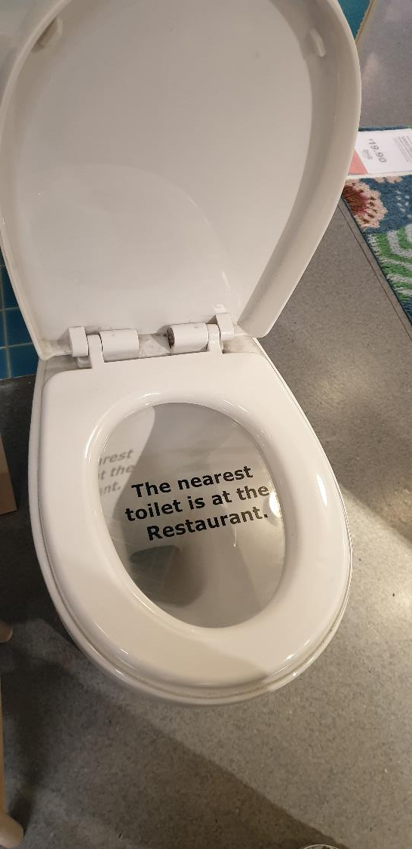
PDSA
Please Do Something. Anything.
Bernard Wong
Quality Improvement Specialist
National Healthcare Group

Slide 91

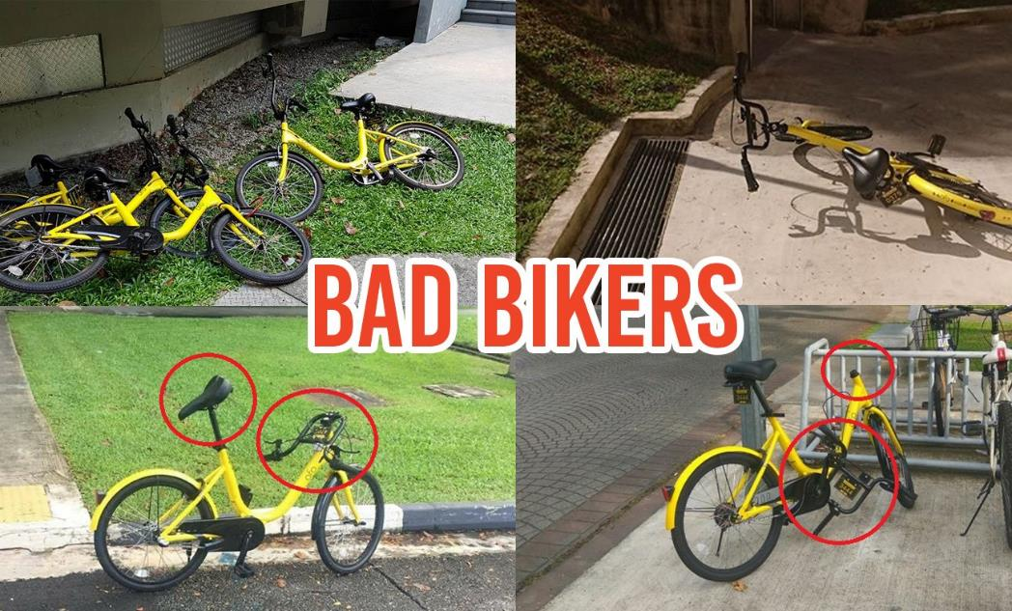
Proposed use
Actual Reality

Slide 92
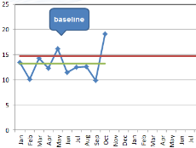
How will we know if a change is an improvement?
3. What changes can we make that will result in improvement?
2. Identifying a measure
Testing Ideas
Identifying a problem +
Evidence
What are we trying to accomplish?
Crafting a mission statement
1. What’s your goal?
Test data
Run chart
Forming a team
Implementing ideas
Diagnostic Journey
Notes:
In your improvement project, selecting your improvement goal, and after beginning to identify the most appropriate measure, how are you making sure that you have enough data to tell you that you have achieved a change for improvement

Slide 93
Testing Change - PDSA
2 Types of study
1st Order Change
What are we trying to accomplish?
(1)
Collective set of interventions proven to work within that context
2nd Order Change
How will we know if a change is an improvement?
Test
2
Test
3
Test
4
Run chart for Mission statement
What changes can we make that will result in improvement?
Test 1
Test
3 &4
Test
1&4
(2)
Process fidelity over time
Act
Plan
Do
Small tests
Study
Actual vs Prediction
Abandon
Hypothesis
Prediction
Adopt
Adapt
Change Concept
Run chart for tests
Better Scientist

Slide 94
How to apply change concepts
Design, print and give - patient education pamphlets
Print : 7000pcs
Patient watch video using portable dvd player
Involve caregiver in the instruction
Patient watch video using mobile phone
Access on demand
Patient watch video using mobile phone,
Nurse will ask for return demo
Freedom to test different ideas
Change concept remains
Change concept
E1. Listen to the patient
E3. Focus on the Outcome to patient
Root cause : Patient cannot remember verbal instructions

Slide 95
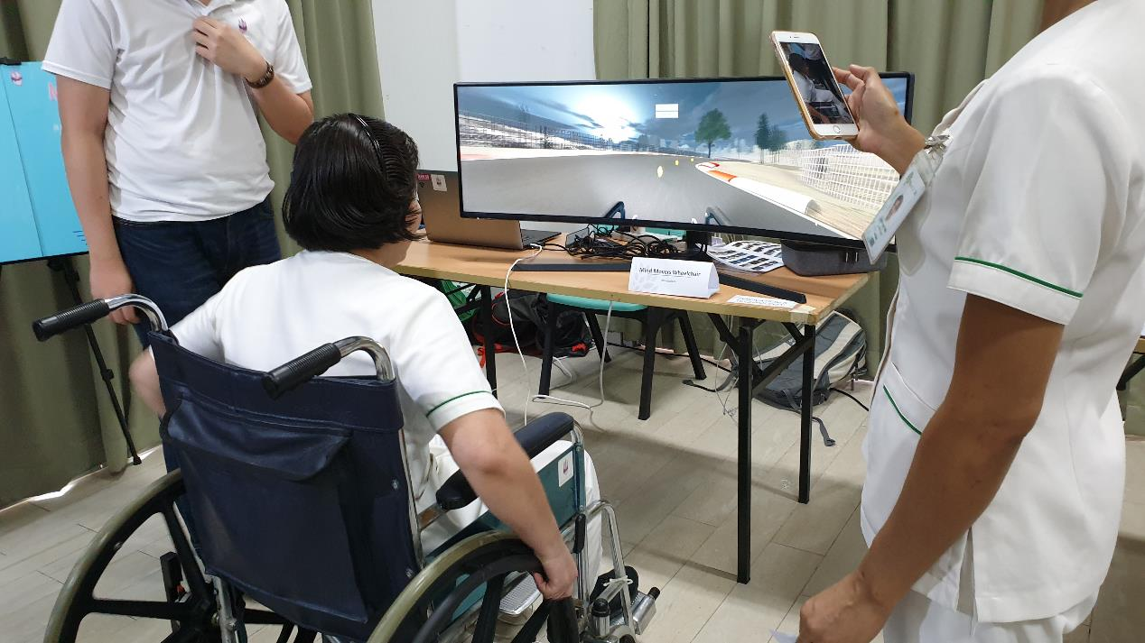
We forgot about the hypothesis, and prediction
All ideas are great, till we test them

Slide 96
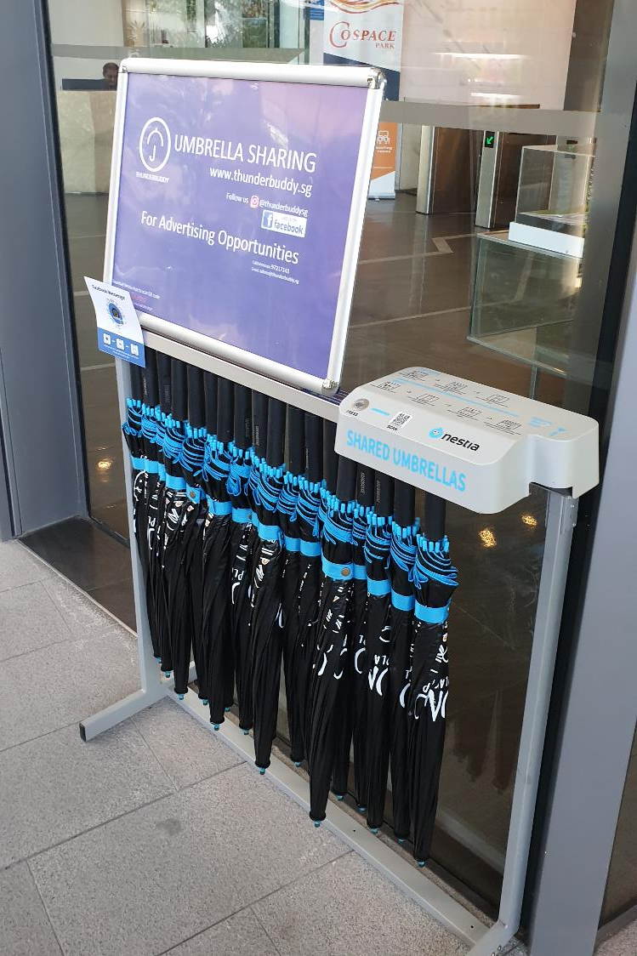
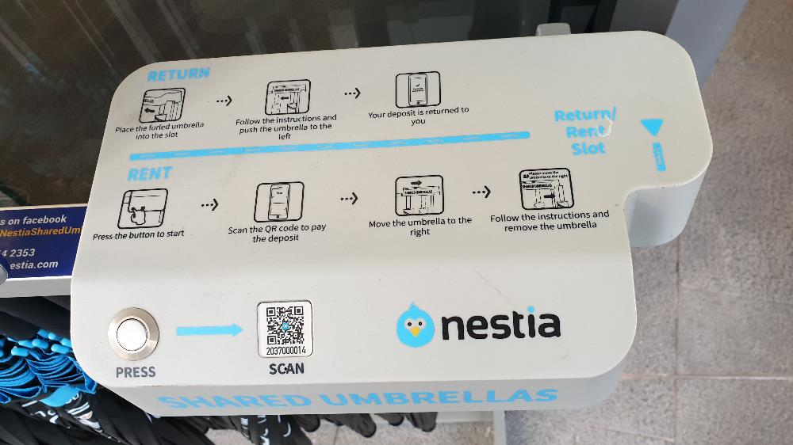
Story 1
Aug 2019

Slide 97
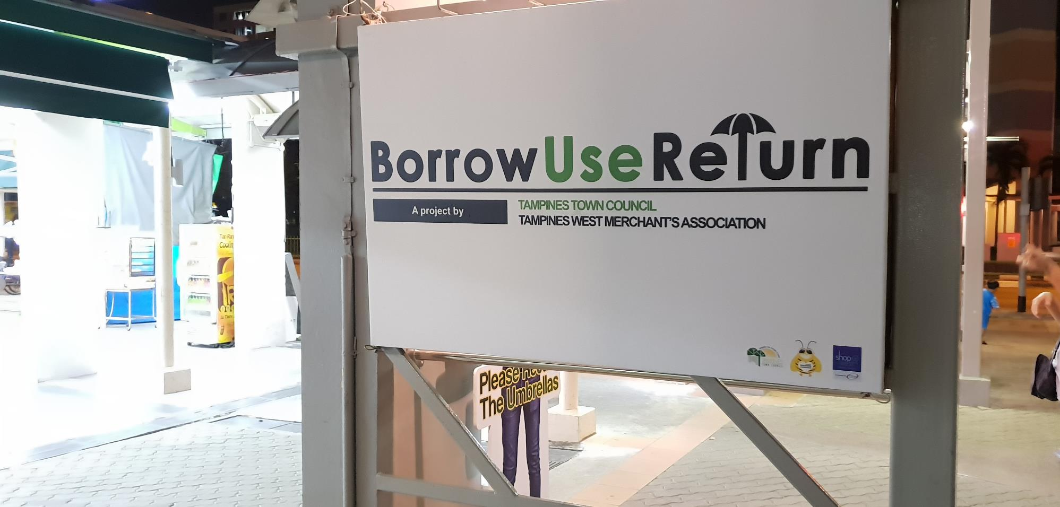
Why have to Pay ?
Jan 2018

Slide 98
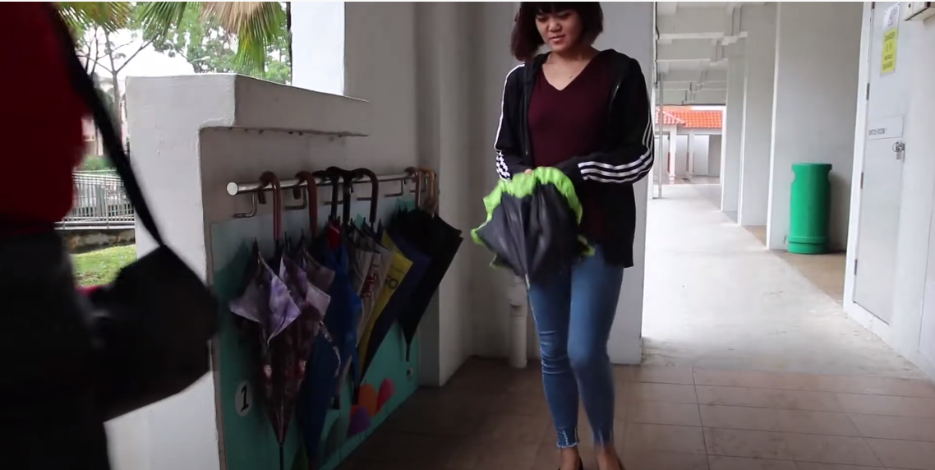
Borrow.Use.Return umbrella station
Jan 2018
Tampines Town Council

Slide 99
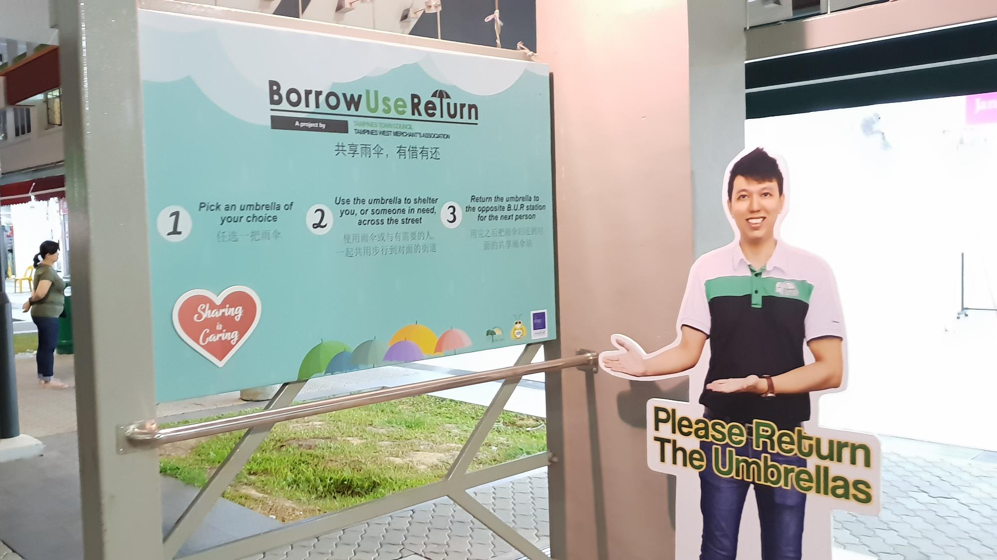
Oct 2018

Slide 100
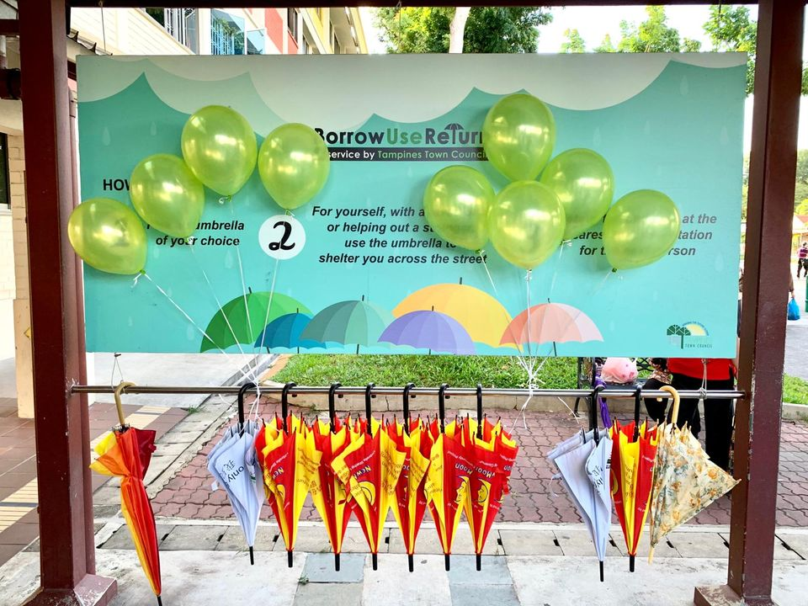
Jan 2019

Slide 101
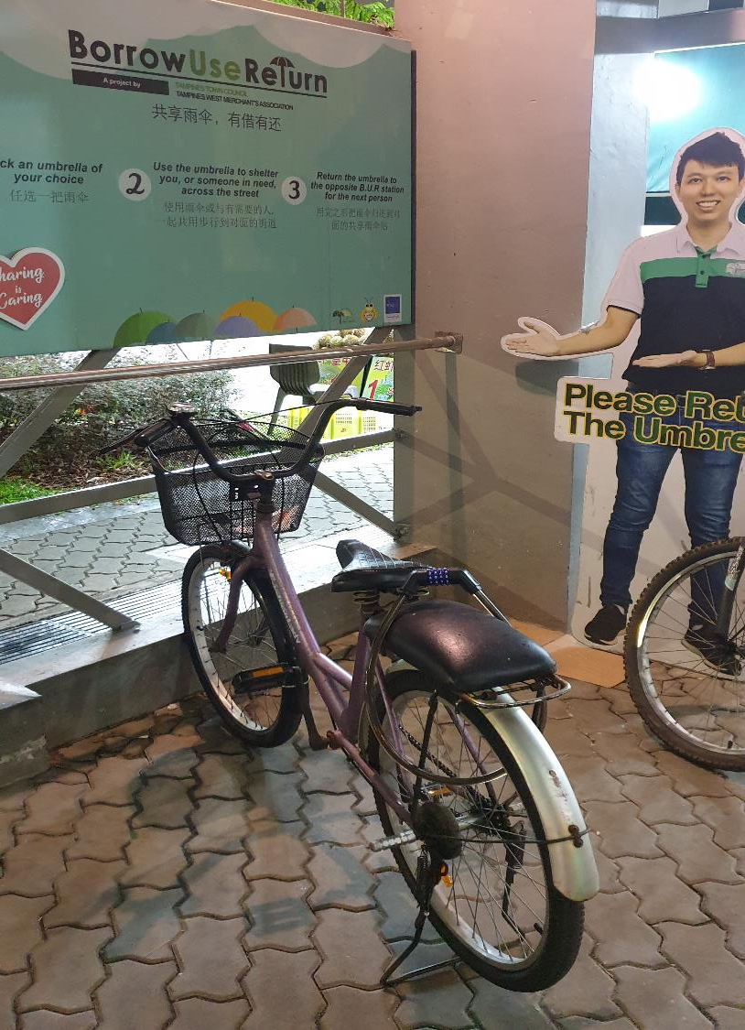
2020 September

Slide 102
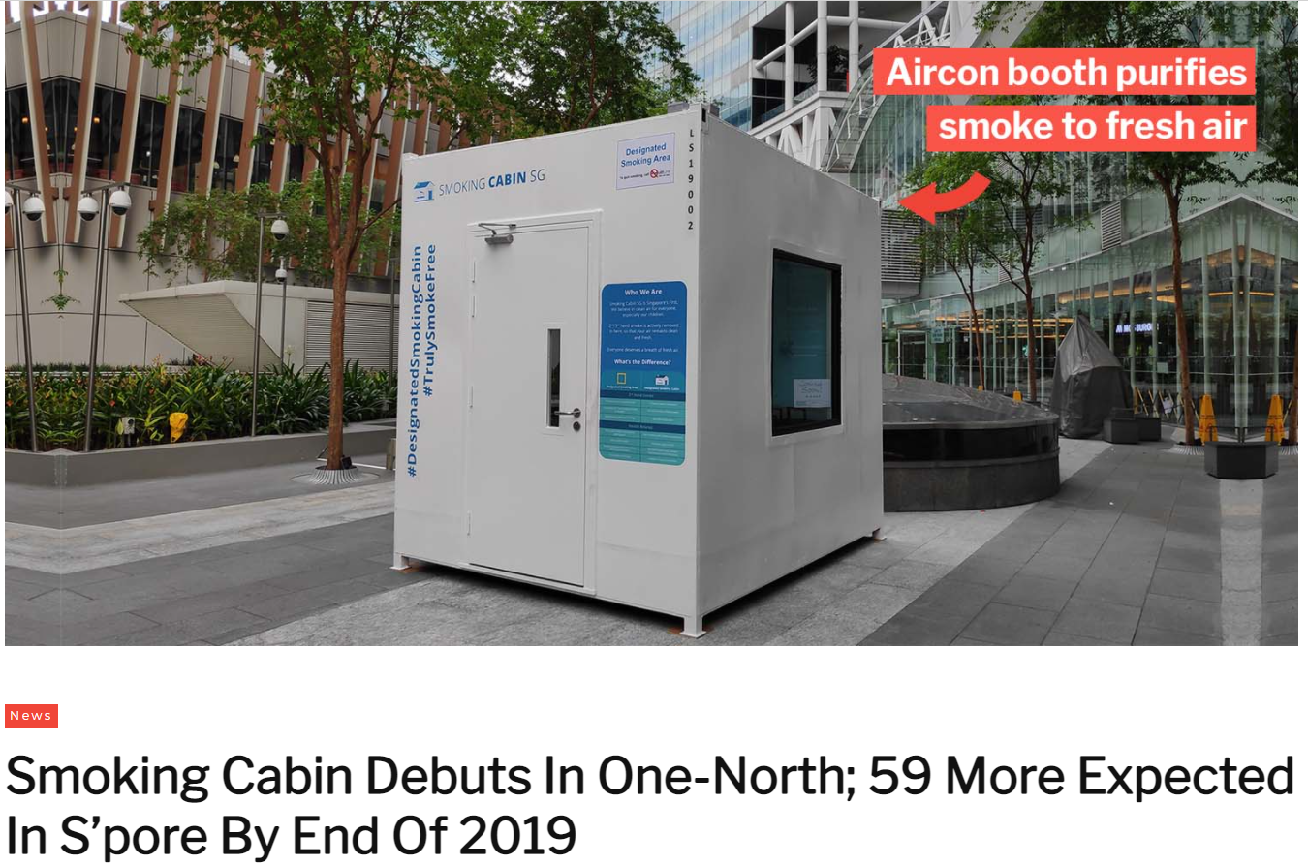
Story 2
(mustsharenews.com)

Slide 103
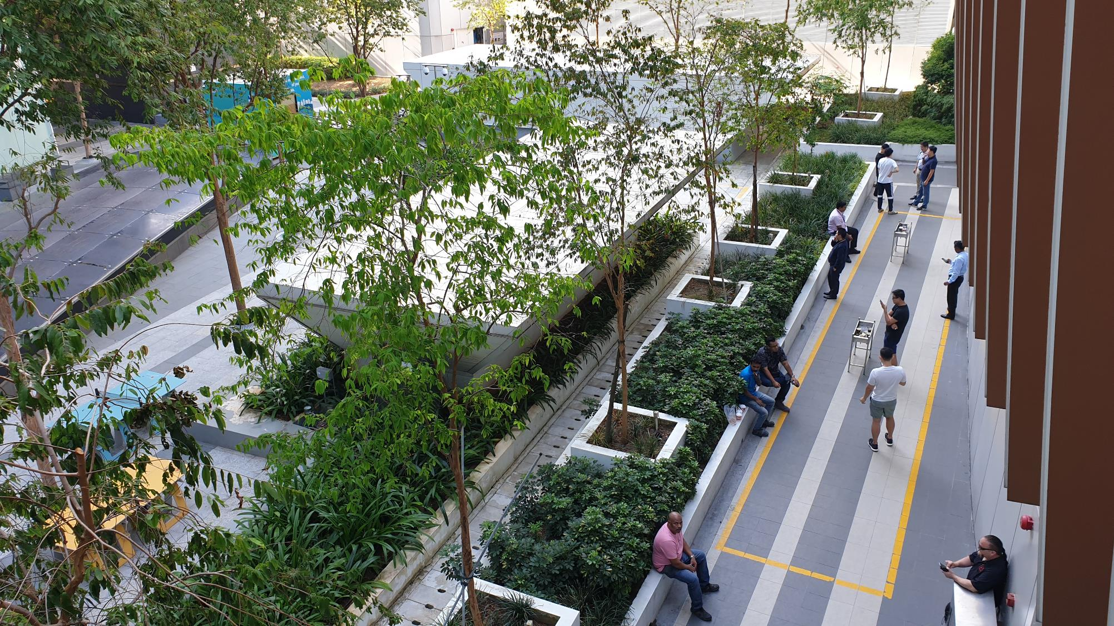
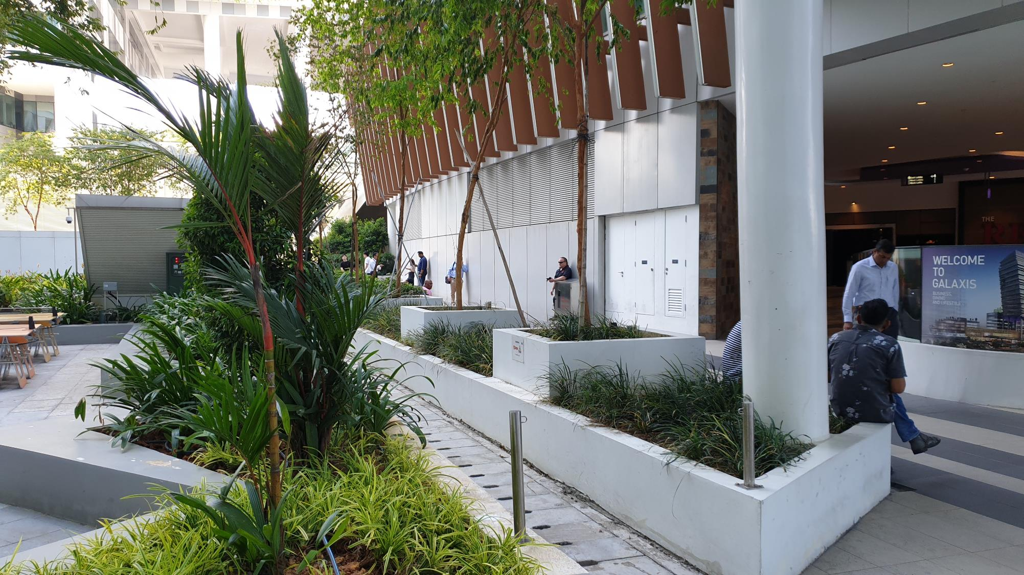

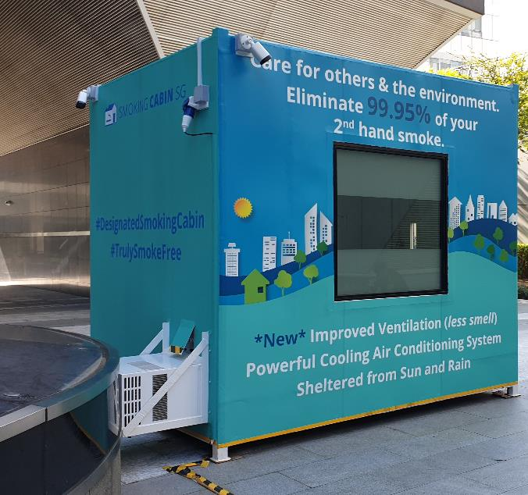
Story 1

Slide 104
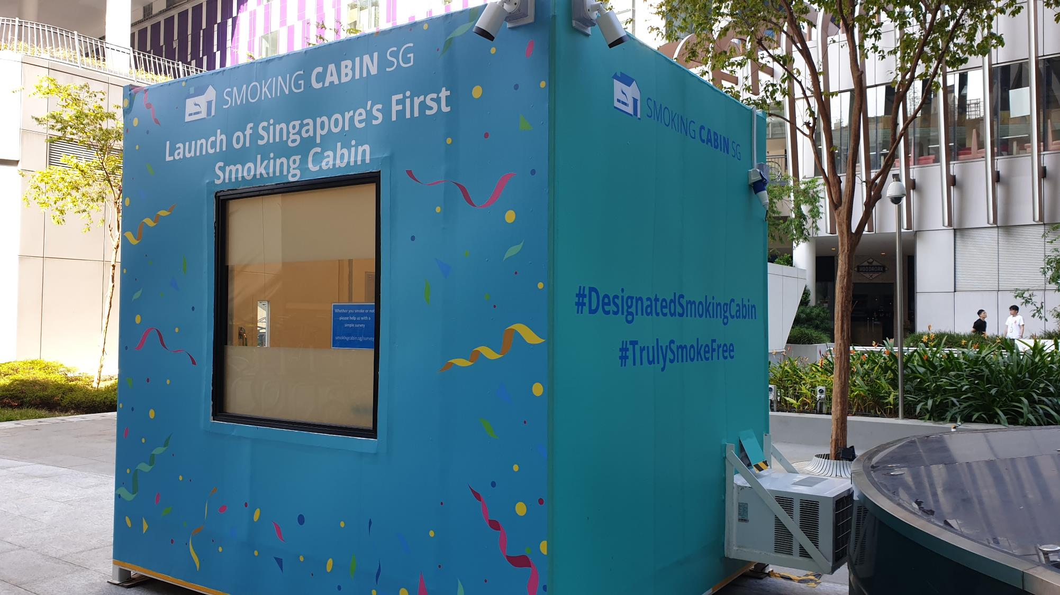

Slide 105
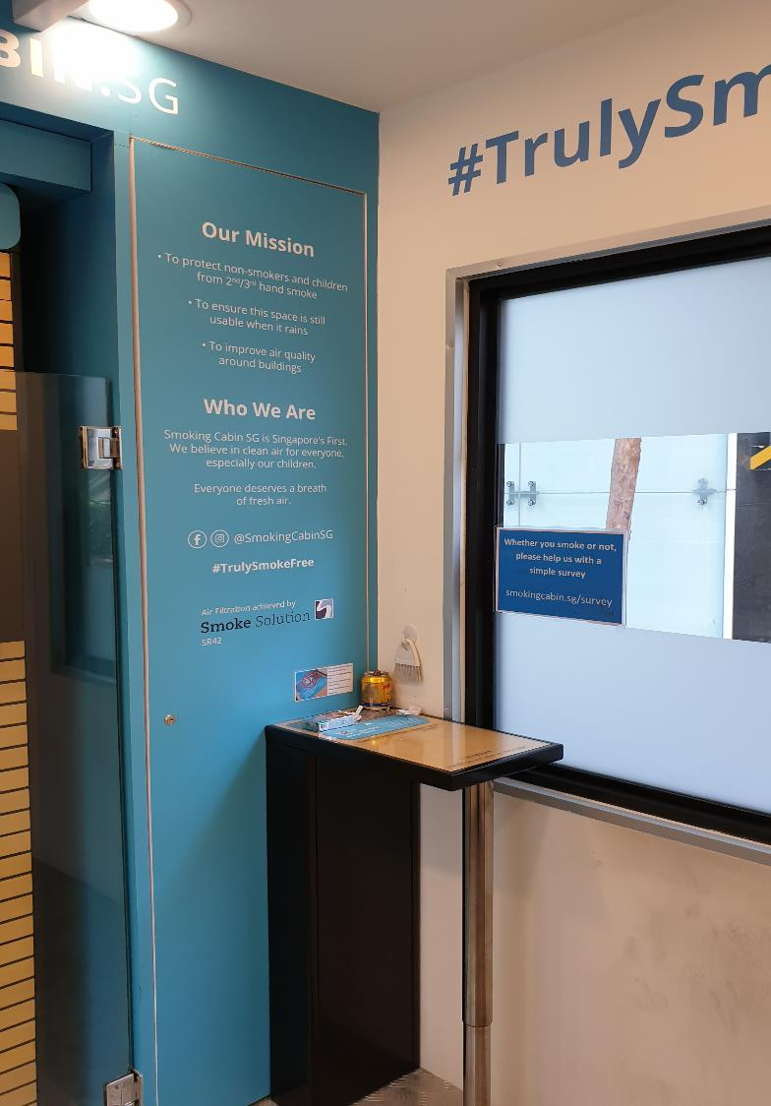
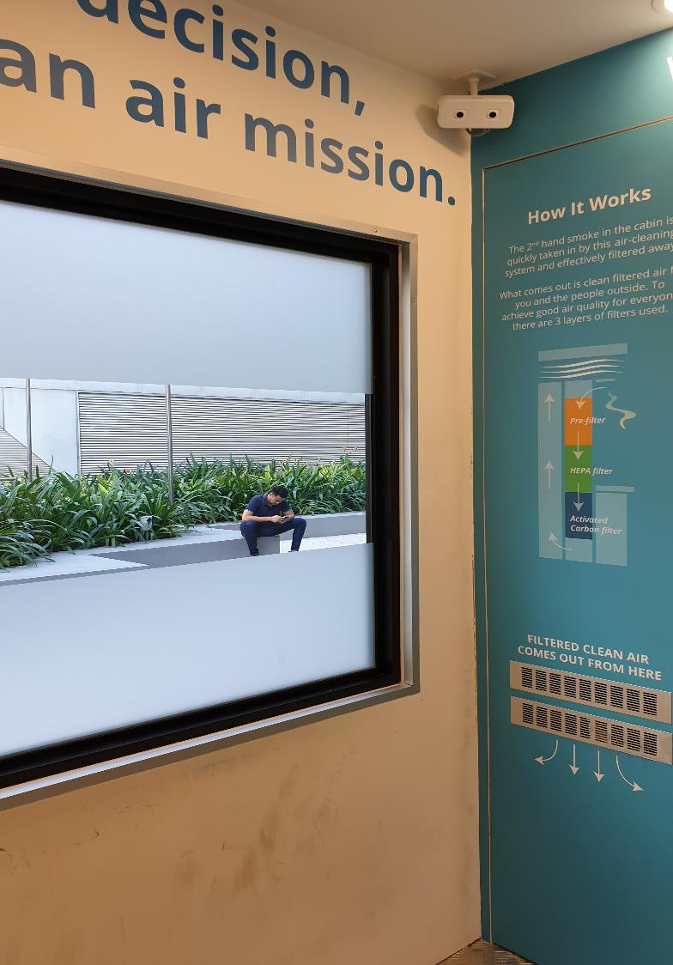

Slide 106
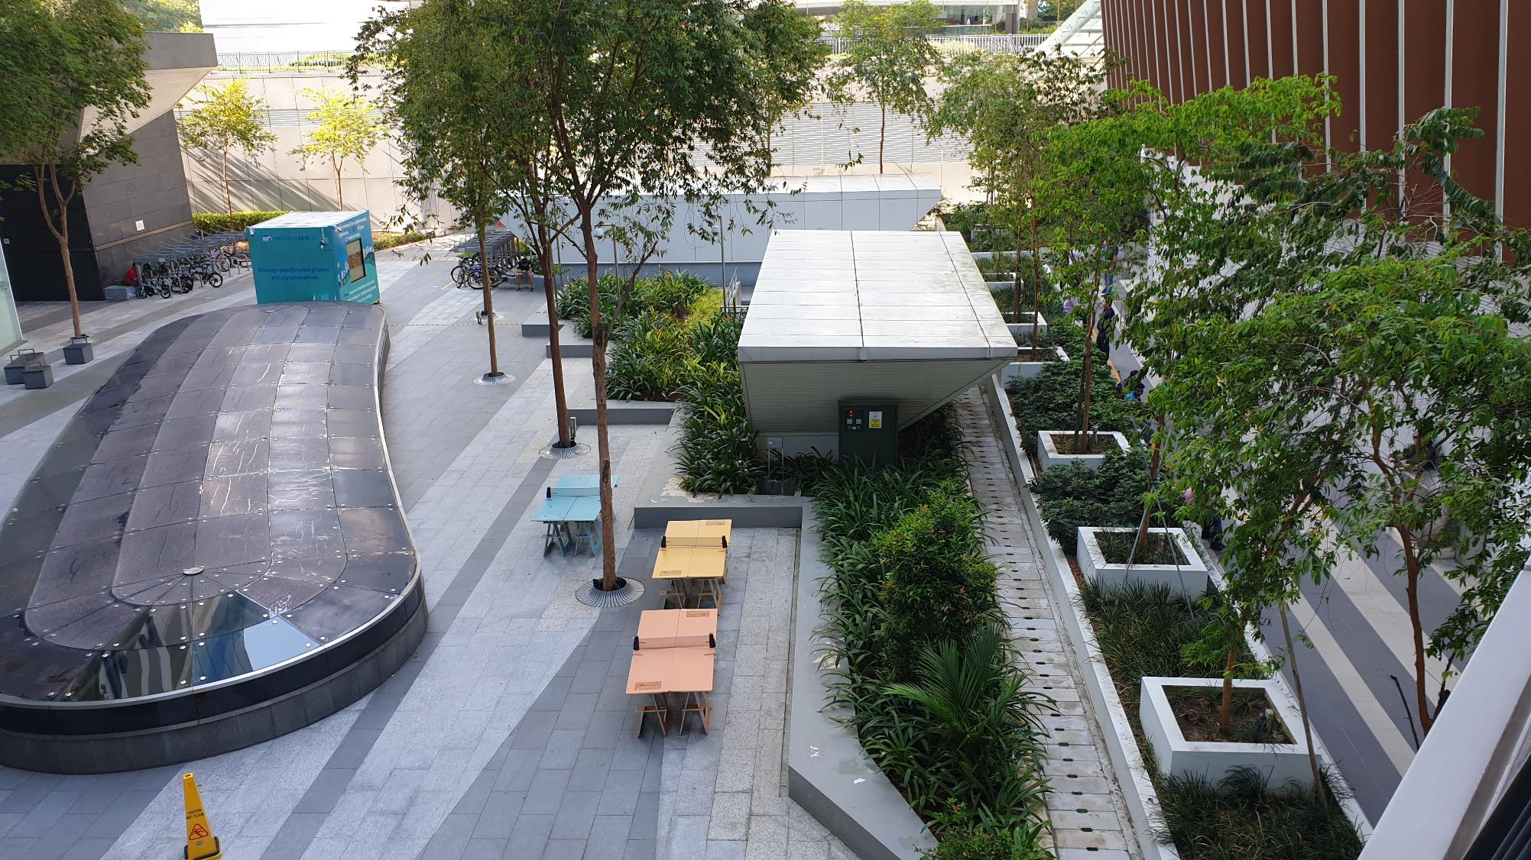

Slide 108
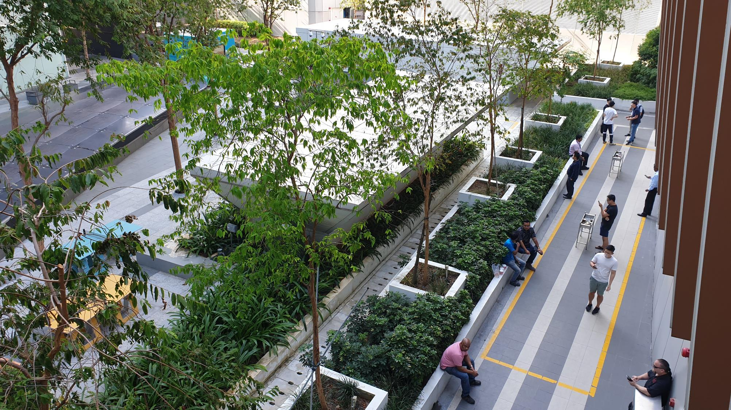

Slide 109
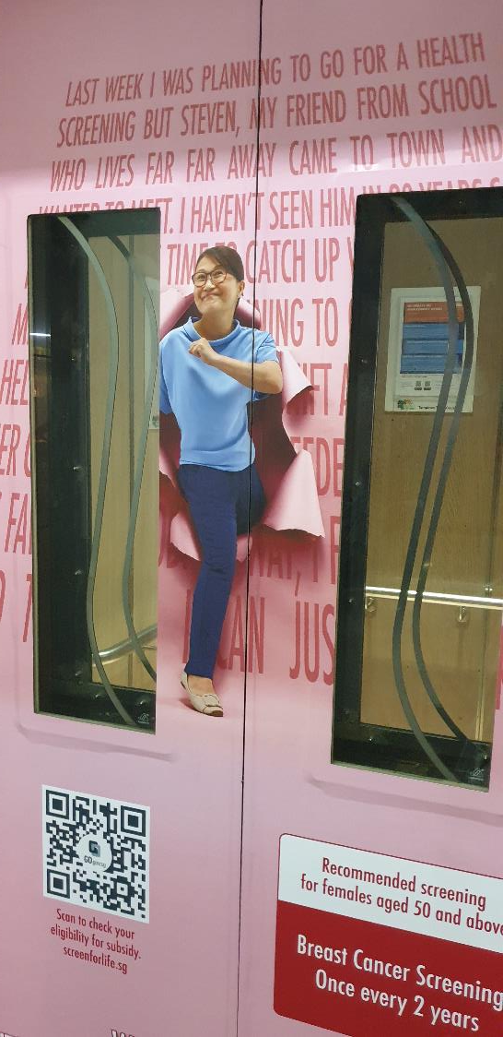

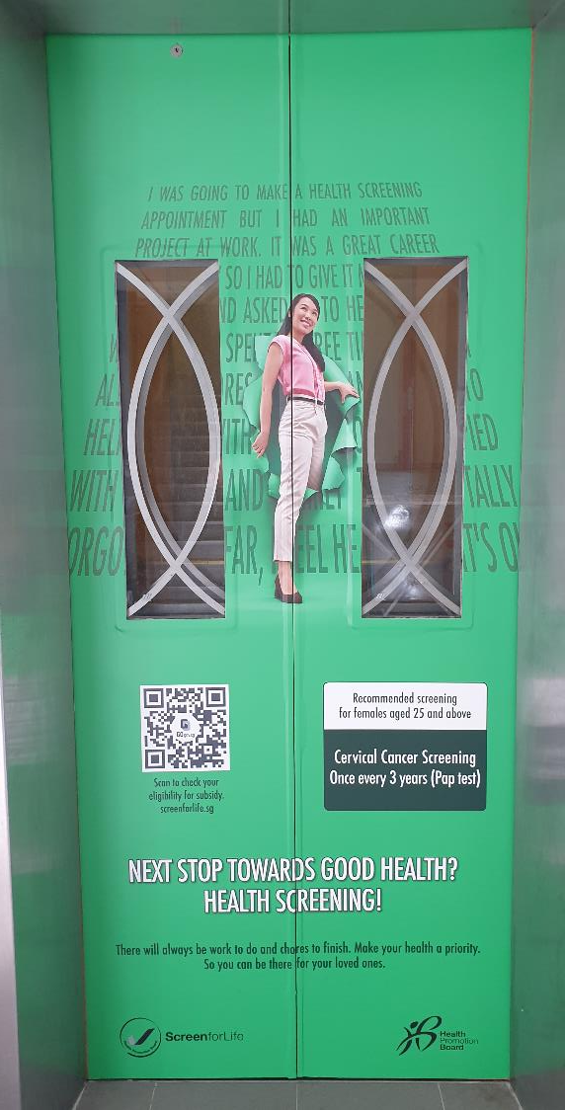
Story 3

Slide 110
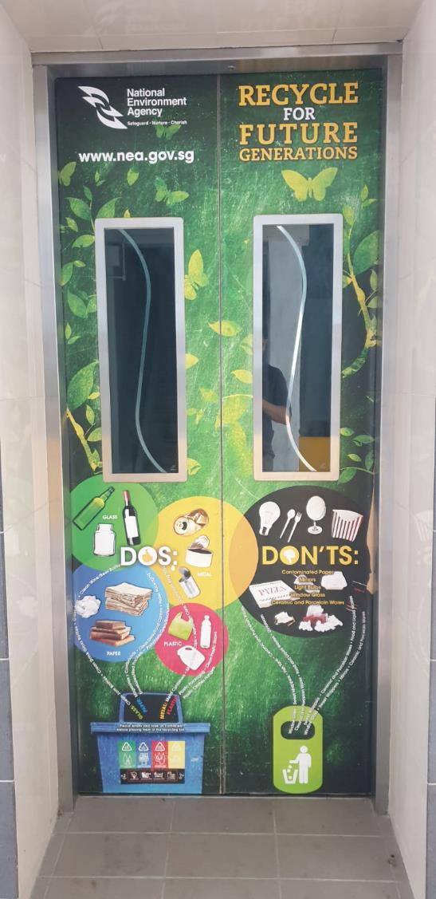

Slide 111
Testing Change - PDSA
2 Types of study
1st Order Change
What are we trying to accomplish?
(1)
Collective set of interventions proven to work within that context
2nd Order Change
How will we know if a change is an improvement?
Test
2
Test
3
Test
4
Run chart for Mission statement
What changes can we make that will result in improvement?
Test 1
Test
3 &4
Test
1&4
(2)
Process fidelity over time
Act
Plan
Do
Small tests
Study
Actual vs Prediction
Abandon
Hypothesis
Prediction
Adopt
Adapt
Change Concept
Run chart for tests
Better Scientist

Slide 112
less is more….
Measuring percentage of usage
Denominator = total no of smokers at Galaxis a month
Denominator = next 5 smokers within 10 mins
Numerator = how many smokers went into the smoking box
Frequency = Mondays 9.45am, Wednesdays 2.45pm, Saturdays 5.00pm
Notes:
Careful observer will be able to spot “reverse engineer the solution” in progress
Perfect design is not about the design being perfect
The human. The willingness for those affected by change to adopt your idea.
What motivates?
Have you involved me ?
(Do the changes TO me, FOR me, or WITH Me ?)

Slide 113
We tend to forget about learning…
Good ideas sometimes need a bit more refinement
Test 1 – 1 – 1 – 3 – 5 – 50
Test 50 – 100 – 1000 – Brownian movement
If you don’t know what will work for 5 persons, how will you know what works for 50 ?
Learning from other pilot tends to fasten your pace (what works, what doesn’t)

Slide 114
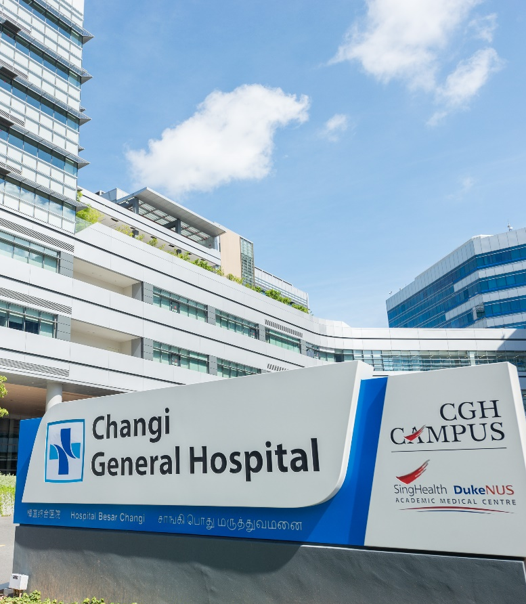
Change Management
What change can we make that will result in improvement?
Project Sharing: Inpatient Hypoglycaemia Prevention
Dr Eberta Tan
Senior Consultant, Department of Endocrinology
Changi General Hospital
12 March 2021

Slide 115
Inpatient Hypoglycaemia Prevention
Problem
High prevalence of hypoglycaemia in general wards
(20% of our inpatients with DM have at least 1 episode of hypoglycaemia).
This translates to unnecessary and potentially preventable morbidity, & prolonged hospitalisation
Aim
Reduce inpatient hypoglycaemia rates in patients with DM admitted to the general wards by 30% over 3 years, without a concomitant increase in hyperglycaemia rates

Slide 116
Driver Diagram
Aim
Primary Drivers
Secondary Drivers
Change Ideas
Decrease inpatient hypoglycaemia rates by 30% in 3 years
Match insulin/SU to nutritional intake
Ensure patients have CBG, insulin/SU & food within the correct time frame
Nurse to coordinate pt care
Predict & prevent hypoglycemia in high risk patients
Standardise the handling of NBM DM patients to prevent iatrogenic hypoglycaemia
Standardise the handling of critical care points in patients with DM
Identification of patients at high risk of hypoglycemia
Prevention of hypoglycaemia in high risk patients
Nurses identify DM patients with poor oral intake & borderline CBG
Patients with DM on dialysis or eGFR<30 given IV actrapid for treatment of hyperK
Nurses omit morning DM medications & discuss dose with doctor
Doctors order a smaller dose of IV actrapid to treat hyperK in at risk patients
Radiology call to SN to remind to suspend DM meds, SN marks CLMM to ensure DM meds not served when NBM, SN closes loop with team doctor to order NBM DM Protocol

Slide 117
1-Nurse Close Loop
Aim
Primary Drivers
Secondary Drivers
Change Ideas
Decrease inpatient hypoglycaemia rates by 30% in 3 years
Match insulin/SU to nutritional intake
Ensure patients have CBG, insulin/SU & food within the correct time frame
Nurse to coordinate pt care
Predict & prevent hypoglycemia in high risk patients
Standardise the handling of NBM DM patients to prevent iatrogenic hypoglycaemia
Standardise the handling of critical care points in patients with DM
Identification of patients at high risk of hypoglycemia
Prevention of hypoglycaemia in high risk patients
Nurses identify DM patients with poor oral intake & borderline CBG
Patients with DM on dialysis or eGFR<30 given IV actrapid for treatment of hyperK
Nurses omit morning DM medications & discuss dose with doctor
Doctors order a smaller dose of IV actrapid to treat hyperK in at risk patients
Radiology call to SN to remind to suspend DM meds, SN marks CLMM to ensure DM meds not served when NBM, SN closes loop with team doctor to order NBM DM Protocol

Slide 118
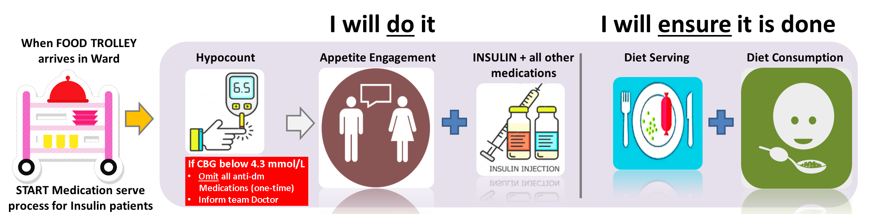
1-Nurse Close Loop
Decrease inpatient hypoglycaemia rates by 30% in 3 years
Match insulin/SU to nutritional intake
Ensure patients have CBG, insulin/SU & food within the correct time frame
Nurse to coordinate pt care
PDSA1
Education of ward nurses
Visual aids in ward as reminders

Slide 119
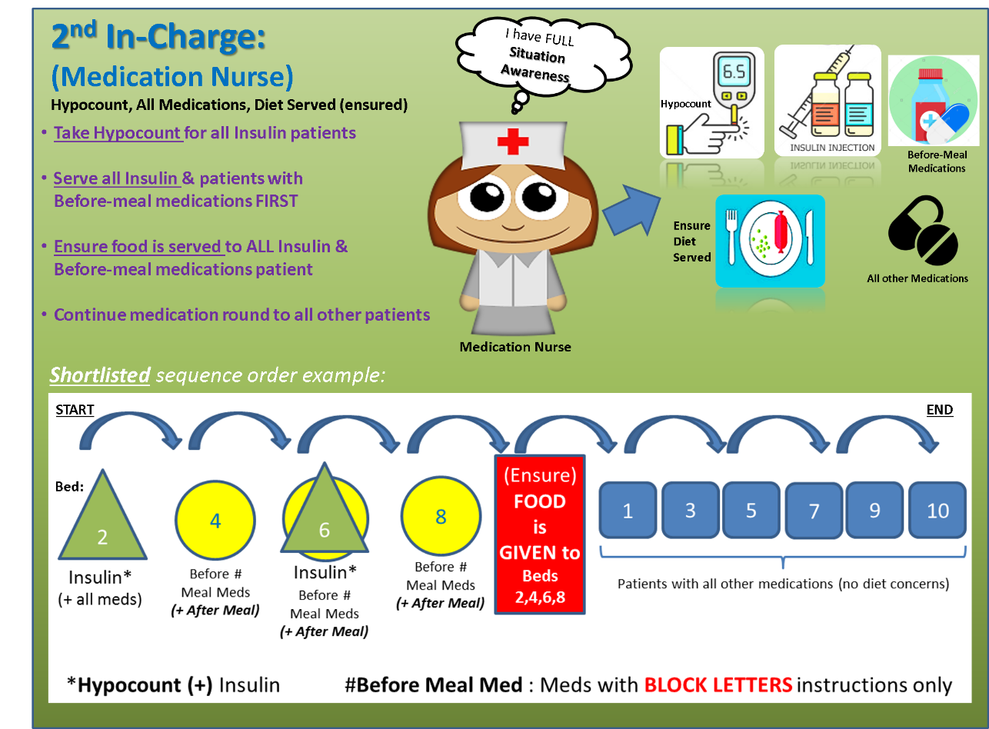
1-Nurse Close Loop
PDSA2
Medication nurse to prioritise patients on insulin and/or oral DM medications
(take CBG, engage on appetite, serve meds, ensure diet served & consumed within 15 min)
Only after the above do they serve medications for the rest of the patients
Restricted, Sensitive (Normal)

Slide 120
1-Nurse Close Loop
PDSA2
Medication nurse to prioritise patients on insulin and/or oral DM medications
(take CBG, engage on appetite, serve meds, ensure diet served & consumed within 15 min)
Only after the above do they serve medications for the rest of the patients
Can do?
Can work?
Feedback from nurses
Difficult to implement – compliance hence poor
Medication nurse takes a long time to perform the whole cycle
The last insulin/OHA patient in the team gets medications/food late due to this
Other patients will end up getting their medications late
Run chart of ward hypo rate
Rates still remained at the baseline of 21%

Slide 121
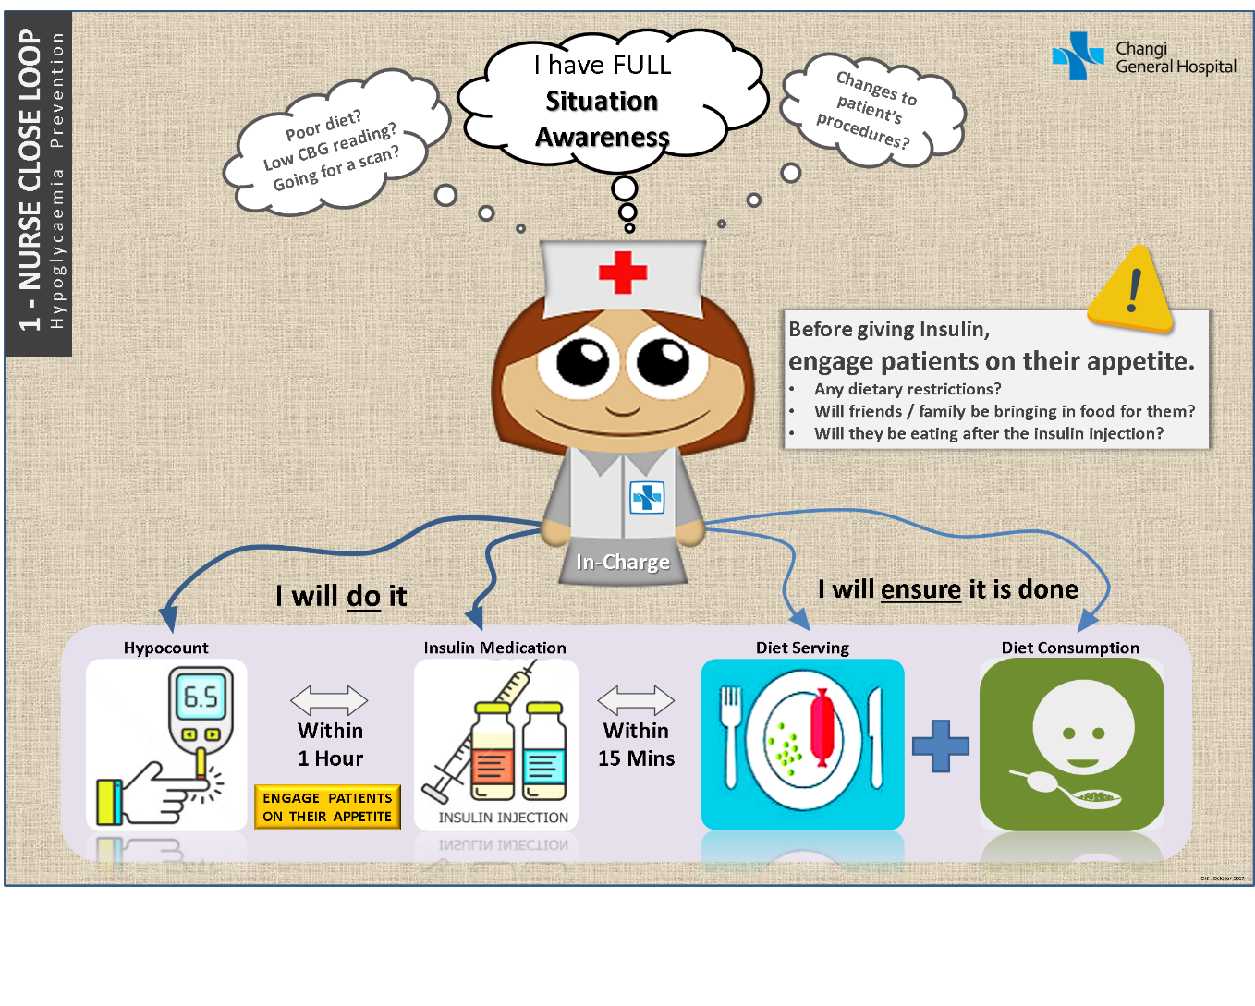
1-Nurse Close Loop
PDSA3
Prioritised patients on insulin only
(medication nurse takes CBG, engage on appetite, serve meds, ensure diet served & consumed within 15min)
Only after the above do they serve medications for the rest of the patients
Restricted, Sensitive (Normal)

Slide 122
1-Nurse Close Loop
PDSA3
Prioritised patients on insulin only
(medication nurse takes CBG, engage on appetite, serve meds, ensure diet served & consumed within 15min)
Only after the above do they serve medications for the rest of the patients
Can do?
Feedback from nurses
Medication nurses were able to handle this workflow
Focusing on just insulin patients streamlined their attention on the highest risk patients without compromising care to other patients
Audit of compliance
# Insulin Patient audited | # Patient’s CBGTaken by Medication Nurse | # Patient’s CBG Taken by EN/ Others
9 | 9 (100%) | 0
# Meal Opportunities (BF / Lunch / Dinner) | # Patient’s meal served within 30 mins of Insulin
47 (9 patients) | 36 (77%)

Slide 123

1-Nurse Close Loop
PDSA3
Prioritised patients on insulin only
(medication nurse takes CBG, engage on appetite, serve meds, ensure diet served & consumed within 15min)
Only after the above do they serve medications for the rest of the patients
Unique Hypoglycaemia Rate, %
4 data points (4 months)

Slide 124

1-Nurse Close Loop
PDSA3
Prioritised patients on insulin only
(medication nurse takes CBG, engage on appetite, serve meds, ensure diet served & consumed within 15min)
Only after the above do they serve medications for the rest of the patients
Unique Hypoglycaemia Rate, %
Pilot Ward 1
Pilot Ward 2
Restricted, Sensitive (Normal)

Slide 125
Audit of compliance to CBG-Insulin-Meal Close-Loop
CBG Reading (Feb 2018)
 | # Insulin Patient audited | # Patient’s CBGTaken by Medication Nurse | # Patient’s CBG Taken by EN/ Others
Pilot W1 | 9 | 9 (100%) | 0
Pilot W2 | 9 | 3 (33%) | 6
Meal Serving (Feb 2018)
 | # Meal Opportunities (BF / Lunch / Dinner) | # Patient’s meal served within 30 mins of Insulin
Pilot W1 | 47 (9 patients) | 36 (77%)
Pilot W2 | 24 (9 patients) | 17 (71%)
Analysis:
Compliance to CBG taken by medication nurse (the dedicated 1-Nurse) was very variable – 100% in Pilot Ward 1, 33% in Pilot Ward 2
Compliance to meal serve within 30 min of insulin was audited to be 71-77%, but very likely better because data was retrospective (ENs key in diet after patient had completed meal, and may not retrospect time to time that meal was actually served)
Pilot Ward 1 was able to comply with the 1-Nurse Close Loop change, but Pilot Ward 2 was less able to
Needed to iron out logistics of 1-Nurse system, in the face of different manpower situations/workflows in different wards
Restricted, Sensitive (Normal)

Slide 126
1-Nurse Close Loop led to a reduction of hypoglycemia
Study of 1-Nurse Close-Loop
Compliance to 1-Nurse Close Loop → Reduction in hypoglycemia
Poor compliance → no reduction in hypoglycemia
Intervention looks effective in reducing hypoglycemia
Hypothesis: Compliance to 1-Nurse Close Loop will possibly lead to a reduction in hypoglycemia in Pilot Ward 2

Slide 127
Refining the change
Worked on improving compliance to 1-Nurse Close Loop in Pilot Ward 2
  Refined the change: Having the In-Charge Staff Nurse oversee CBG-Insulin-Food loop would work better for Pilot Ward 2

Slide 128

Refining the change
  Unique Hypoglycaemia Rate in Pilot Ward 2, %
August 2018
PDSA 5:
In-Charge to oversee 1-Nurse Workflow

Slide 129
LEARNING POINTS
It is important to monitor the primary outcome
It is equally important to monitor process measures
Both will inform effectiveness, compliance, and expose any problems with the processes
A negative outcome in this case was due to poor compliance to the intervention
Interventions often need to be adapted to be adopted successfully, especially if there is a significant human factor involved

Slide 130

Driver Diagram
Aim
Primary Drivers
Secondary Drivers
Change Ideas
Decrease inpatient hypoglycaemia rates by 30% in 3 years
Match insulin/SU to nutritional intake
Ensure patients have CBG, insulin/SU & food within the correct time frame
Nurse to coordinate pt care
Predict & prevent hypoglycemia in high risk patients
Standardise the handling of NBM DM patients to prevent iatrogenic hypoglycaemia
Standardise the handling of critical care points in patients with DM
Identification of patients at high risk of hypoglycemia
Prevention of hypoglycaemia in high risk patients
Nurses identify DM patients with poor oral intake & borderline CBG
Patients with DM on dialysis or eGFR<30 given IV actrapid for treatment of hyperK
Nurses omit morning DM medications & discuss dose with doctor
Doctors order a smaller dose of IV actrapid to treat hyperK in at risk patients
Radiology call to SN to remind to suspend DM meds, SN marks CLMM to ensure DM meds not served when NBM, SN closes loop with team doctor to order NBM DM Protocol

Slide 131
More pdSA
Our current interventions may be still missing some at risk patients not targeted by the 1-Nurse Close Loop
Findings: 1/3 of patients with a pre-breakfast CBG of 4-4.3 developed hypoglycemia within the next 48h, 1/3 of these occur at pre-breakfast the next morning

Slide 132
Driver Diagram
Aim
Primary Drivers
Secondary Drivers
Change Ideas
Decrease inpatient hypoglycaemia rates by 30% in 3 years
Match insulin/SU to nutritional intake
Ensure patients have CBG, insulin/SU & food within the correct time frame
In-charge nurse to coordinate pt care
Predict & prevent hypoglycemia in high risk patients
Standardise the handling of NBM DM patients to prevent iatrogenic hypoglycaemia
Standardise the handling of critical care points in patients with DM
Identification of patients at high risk of hypoglycemia
Prevention of hypoglycaemia in high risk patients
Nurses identify DM patients with poor oral intake & borderline CBG
Patients with DM on dialysis or eGFR<30 given IV actrapid for treatment of hyperK
Nurses omit morning DM medications & discuss dose with doctor
Doctors order a smaller dose of IV actrapid to treat hyperK in at risk patients
Radiology call to SN to remind to suspend DM meds, SN marks CLMM to ensure DM meds not served when NBM, SN closes loop with team doctor to order NBM DM Protocol
How?

Slide 133

Refining the change
33% of hypos occur the next morning (0500-0759h)
Version 1 of titration protocol prompted primary team doctors to review and stop/down-titrate pre-dinner/ON SUs & insulin doses, targeting the prevention of hypoglycemia the next morning (33% of events).
Restricted, Sensitive (Normal)

Slide 134


PDSA cycles for Medication Titration Protocol
Medication Titration Protocol
P
Predicting high risk patients
A pre-breakfast CBG of 4-4.3mmol/L predicts a high risk of a hypoglycemic event occurring in a patient with DM.
Medication Titration Protocol
Nurse identifies high risk patient & flags case up to the team doctor to titrate night doses of insulin/SU
Study the Data to Inform…
Effective intervention: Cut hypoglycemia rate by 50% (in particular the next morning)
However, there was a significant rate of hypoglycemia the same day as DM meds were served
…and Refine
Medication nurse is empowered to withhold that morning’s DM medication
Follows through with team doctor regarding medication dose changes
Medication Titration Protocol (Version 1)
D
S
A

Slide 135

Medication Titration Protocol
P
Predicting high risk patients
A pre-breakfast CBG of 4-4.3mmol/L predicts a high risk of a hypoglycemic event occurring in a patient with DM.
Medication Titration Protocol
Nurse identifies high risk patient, omits morning DM medications & flags case up to the team doctor to titrate doses of insulin/SU
Study the Data to Inform…
Process measures: Good compliance & feedback on feasibility
Reduced hypoglycemia rates by 80% in high risk pts identified for this protocol with no untoward effects on increasing hyperglycemia
However, this still misses out on identifying certain patients who are at risk of hypoglycemia
We studied how we could identify these patients we “missed” with this protocol
60-80% of hypoglycemic events occurred within 24 hours in patients with a poor diet intake the prior day, with pre-breakfast CBG 4 to 6 & who were given SUs/insulin
…and Refine..
Medication Titration Protocol (Version 2)
D
S
A

Slide 136

Medication Omission Protocol
A
…and Refine the identification of high risk pts
Medication Titration Protocol (Version 3)
Restricted, Sensitive (Normal)

Slide 137

Run chart in Pilot Ward 3
Pilot Wards Data Chart – till July 2019 – Unique Episodes

Slide 138
LEARNING POINTS
Data informs us about
  whether we need to refine the change
  How we should refine the change
Sometimes change needs time to be adopted/incorporated - Collect a few data points before concluding the effectiveness of a change
Supportive team members are a big blessing – they buy-in to the data and interventions being suggested and try their best to implement them on the ground

Slide 139

Restricted, Sensitive (Normal)

Slide 140

Thank you!
The Team
* Photo was taken pre-COVID-19
Endocrinology
(Project Leaders)
Wards 29, 36, 45, 48, 56
Diabetic Centre
Pharmacy
Dietetic Consultation
Office of
Improvement Science
*Partial Team Photo
Notes:
I’d like to start off by saying that we were blessed to achieve good results in our project due to these people here – having a dedicated team from different departments working together is the beginning of the road to improvement.

Slide 141
Harvest Sheet
 | Strategic Measures (Team 1) | Improvement Aim Measures (Team 2) | PDSA measures (testing changes) (Team 3)
What did I learn (about measurement) ?
What challenges did this team face ?
How did the team overcome their problem/s?
One idea I can try to adopt

Slide 142


Slide 143
Panel discussion by Dr Alvin (Moderator), Dr Siow Team member(s), Ms Pang, John Team member(s), Mr Bernard, Garry Team member(s) - (20mins)
Summary of key takeaways & Closing by Dr Alvin, Ms Pang and Mr Bernard (5mins)

